Slide 1

Rethinking MIMD-SIMD Interplay for Analytical Query
Processing in In-Memory Database Engines
A Unified Approach For Efficient Query Processing
Presented by:
Stylianos Vassiliou
Panteleimonas Chatzimiltis

Slide 2
Presentation Overview
Necessary background
  SIMD
  MIMD
Introduction
Case Study
Conclusion
Q/A

Slide 3
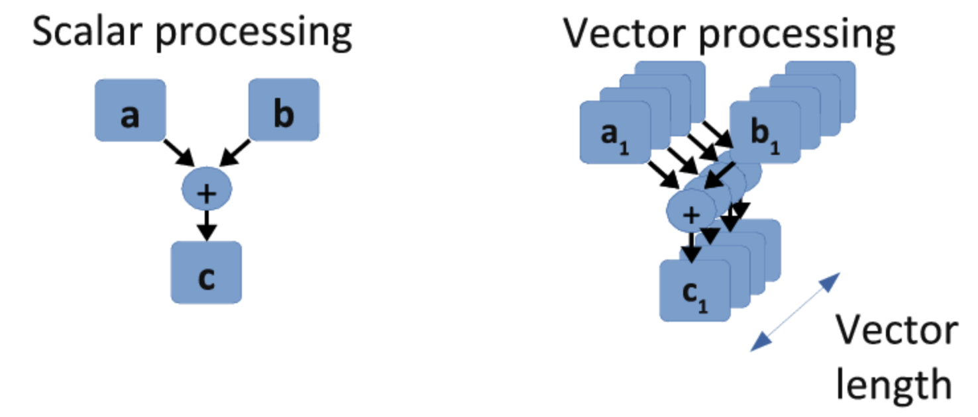
Data-Level Parallelism (SIMD)
Notes:
The Main idea behind data-level parallelism is that using one instruction can prosses multiple data
As we can see, a scalar instruction can only process one operation at a time, whereas vector instruction can process multiple operations.

Slide 4
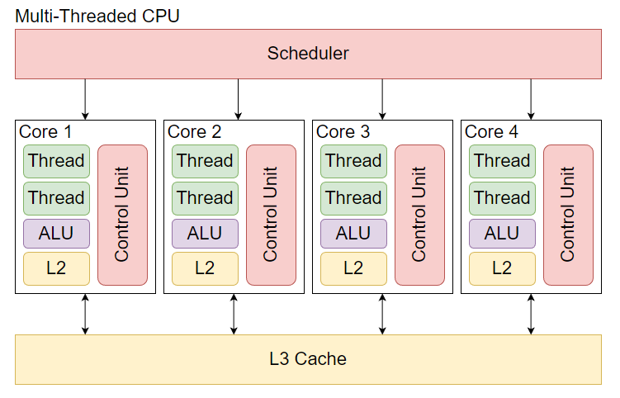
Thread-Level Parallelism (MIMD)
Notes:
- Now, the thread-level parallelism comes from the ability to process multiple data simultaneously on different cores.

Slide 5
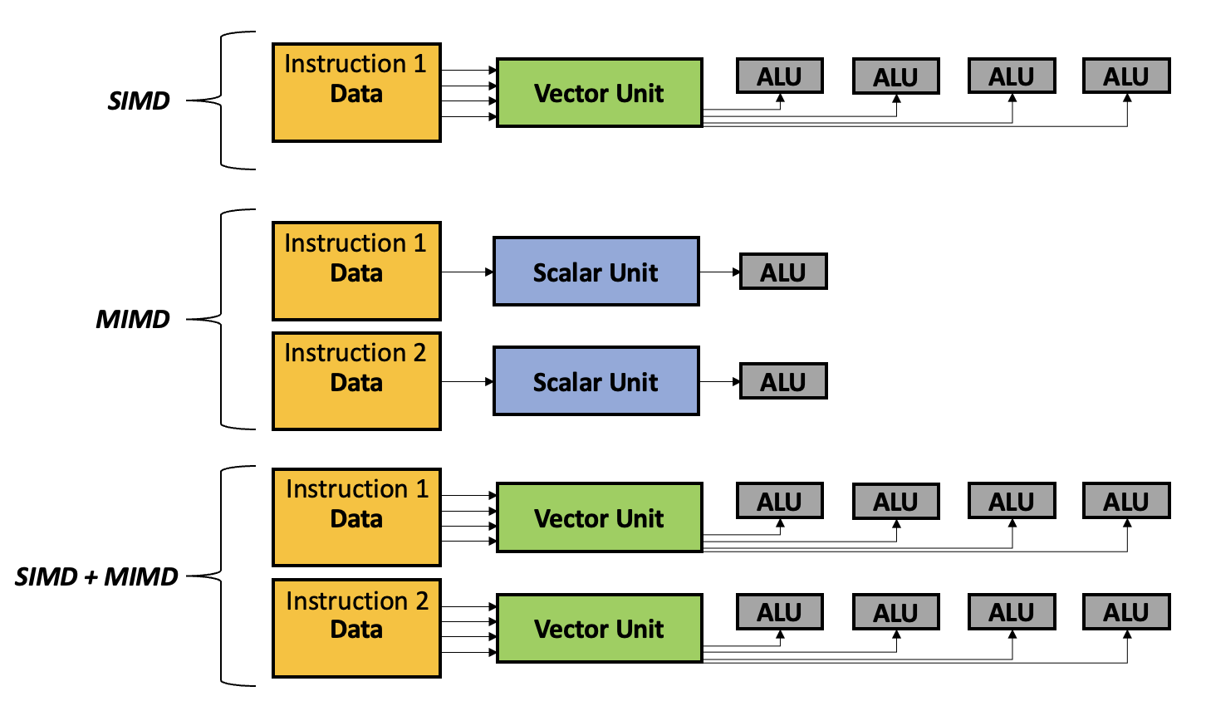
Parallelism: Unlocking High-Computational Power
SIMD: A single instruction operates on multiple data elements simultaneously.
Notes:
In a schematic overview
SIMD outstands for that a Single instruction operates on multiple data elements simultaneously

Slide 6
Parallelism: Unlocking High-Computational Power
SIMD: A single instruction operates on multiple data elements simultaneously.
MIMD: Independent cores, execute different instructions to different data
Notes:
MIMD is that, Intependent cores execute different instructions to different data

Slide 7
Parallelism: Unlocking High-Computational Power
SIMD: A single instruction operates on multiple data elements simultaneously.
MIMD: Independent threads, execute different instructions to different data
SIMD + MIMD: Independent cores, execute single instructions that operate on multiple data elements simultaneously.
Notes:
The combination of two is that independent cores, can execute single instructions that operate on multiple data elements simultaneously
- The optimization of this approach is the goal of this paper on query processing

Slide 8
Introduction
Problem:
Complex queries have high latency and low throughput on large amounts of data.
Notes:
They tried to solve the problem of queries that depend on large amounts of data have high latency and low throughput

Slide 9
Introduction
Problem:
Processing complex queries with low latency and high throughput on large amounts of data.
Goal:
Develop a unified parallelization approach to achieve high-computational power that effectively integrates MIMD and SIMD improved performance.
Notes:
- Their goal was to develop unified parallelization approach which integrates mimd and simd to achieve high-computational power for such queries.

Slide 10
Introduction
Problem:
Processing complex queries with low latency and high throughput on large amounts of data.
Goal:
Develop a unified parallelization approach to achieve high-computational power that effectively integrates MIMD and SIMD improved performance.
Idea:
Utilize modern CPU support for non-contiguous SIMD memory access to enable a hybrid MIMD-SIMD parallelization strategy.
Notes:
- To do this they took advantage of the modern CPUs support for non-contiguous SIMD memory access, to combine MIMD’s flexibility with SIMD’s efficiency, optimizing parallel processing for better performance.

Slide 11
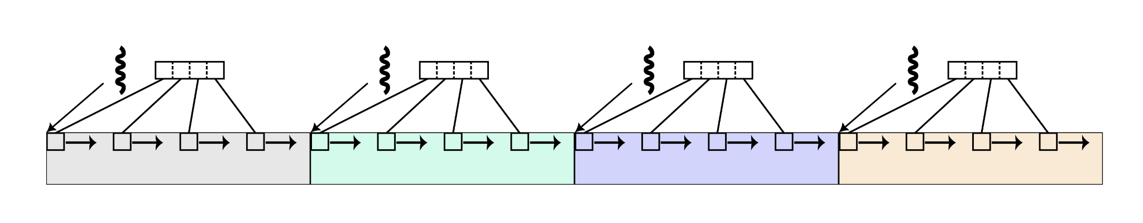
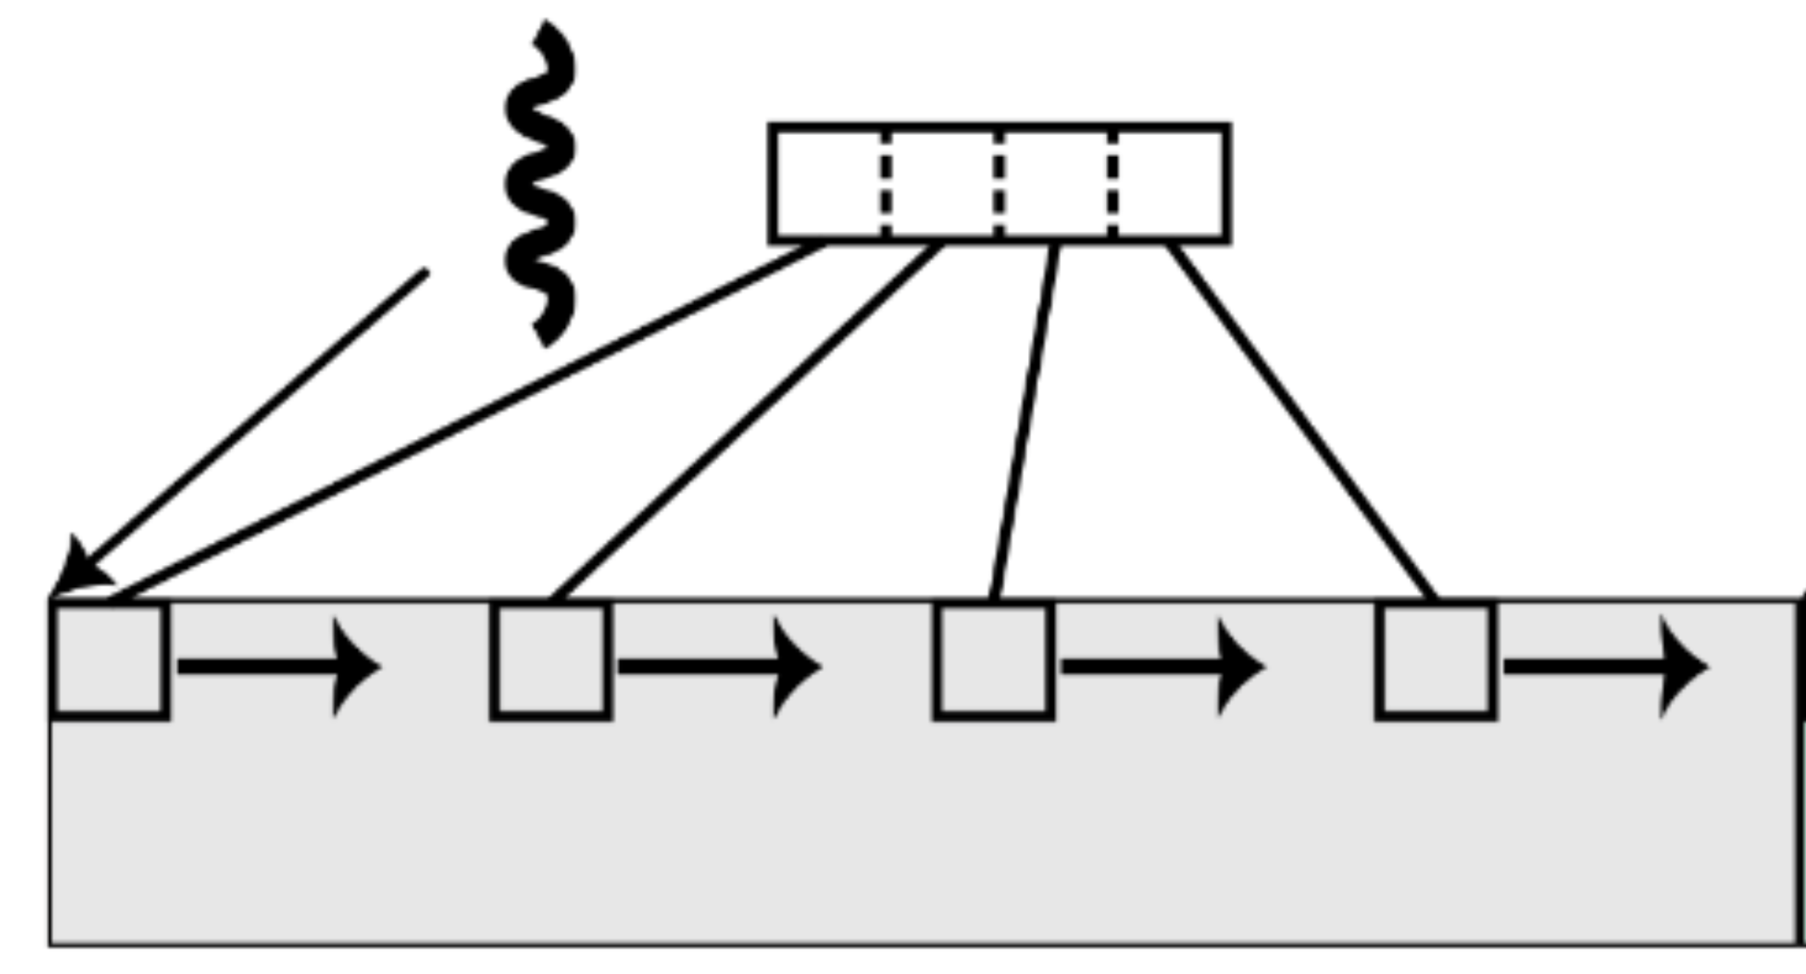
SIMD and MIMD Interplay on Query Processing
Core 1
Core 2
Core 3
Core 4
Column 1
Column 2
Column 3
Column 4
Vector Instr 1 … Vector Instr 4
Notes:
In this figure they showed in detail how the SIMD and MIMD interplay can be used for query processing optimization.
They divide each column processing on different cores.
Calculations for each column use vector instructions to process multiple data elements with fewer operations.
For example, without vectors, 16 instructions are needed, but with SIMD, only 4 are required per column.

Slide 12
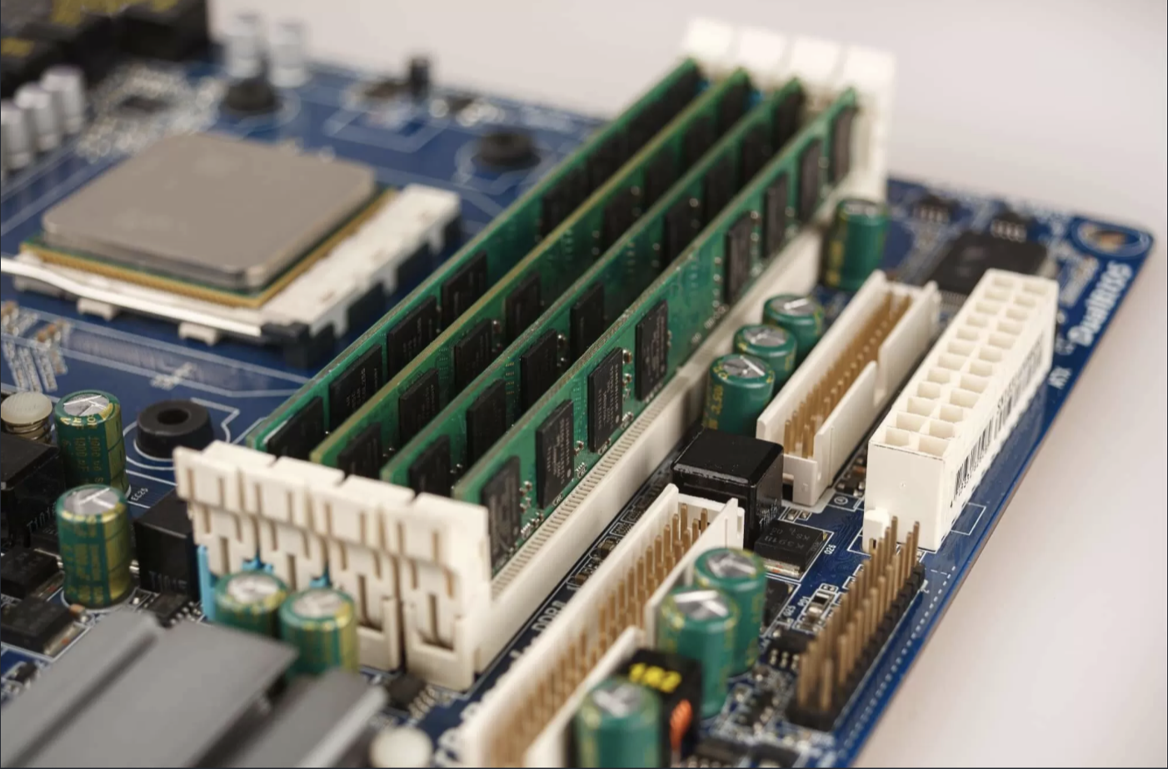
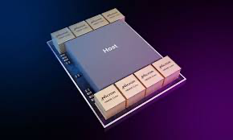
DRAM and HBM memory systems
DRAM very close to CPU: HBM
CPU
DRAM
CPU
Less bandwidth
Modularity
Scalability
Higer bandwidth – Faster transition of data
Notes:
Their experiments were conducted on two different memory systems.
DRAM is the traditional main memory that offers more modularity and scalability.
HBM on the other hand, has higher bandwidth than DRAM, since its much closer to the processor.
But, HBM is not salable nor modular since it is integrated inside the processor, whereas the DRAM has much less bandwidth than the HBM since its further away from processor.

Slide 13
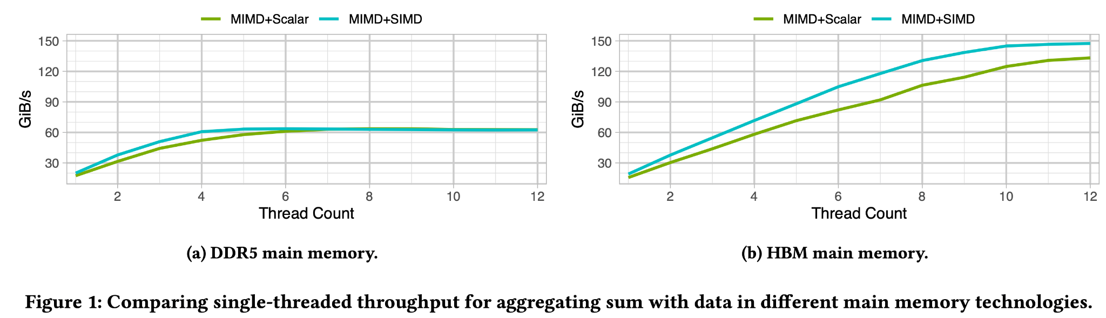
SIMD and MIMD Interplay on Query Processing
DRAM very close to CPU: HBM
CPU
Notes:
Here we see an experiment where they use Multithreading on its own, and multithreading with vectors.
We see that DRAM utilizes the full bandwidth with just MIMD, whereas in HBM can be further improved by including SIMD.

Slide 14
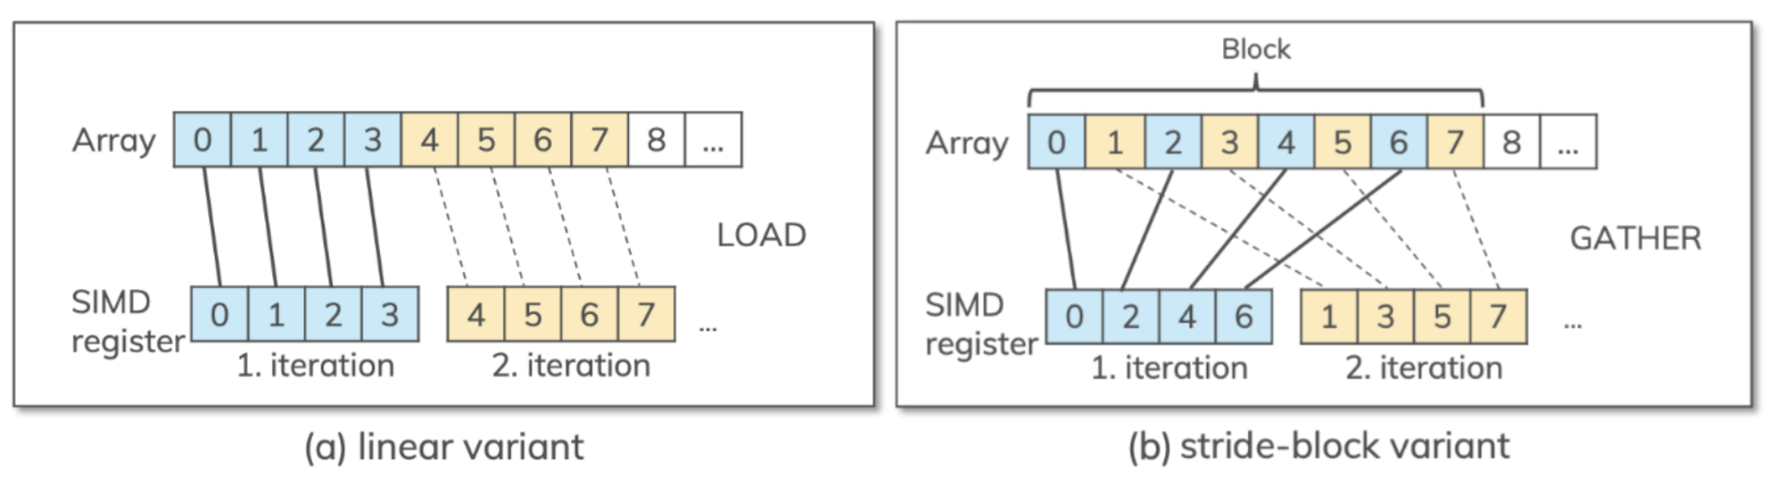
Linear and Gather(Strided) Access Patterns
Notes:
The state-of-the-art is to load each vector register serially, meaning to load one data elements sequentially as we see in figure a, this is refered as the linear access pattern.
But, they suggest a novel way to load data in vector registers by loading them in a round-robin fashion based on how many vecor registers there are.
For example if they are only 2 SIMD registers as we can see in figure b, it will load 1 element for the register and the second one to the second register, the third to the first again and so on.
They called this gathertrided access pattern.

Slide 15
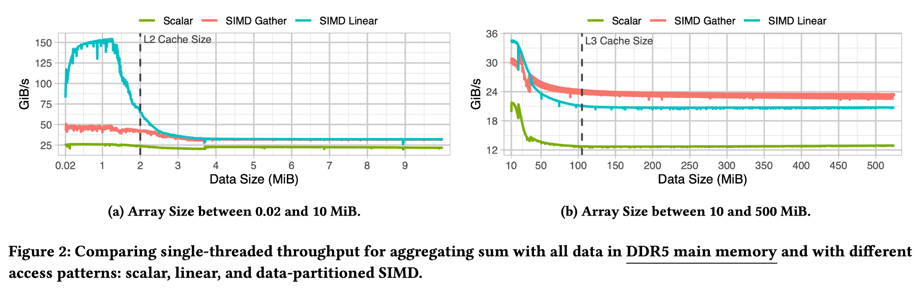
Linear vs. Gather Data Accesses
Notes:
Here they compare the scalar execution with the two vector approaches (with Linear and Gather memory access patterns).
They compare them by changing the array size first when it fits fully inside the cache (figure a) and then when it doesn’t (figure b)
As we can see in all cases both vector access patterns outperform the scalar execution.
When we compare the SIMD linear and gather, we see that all the data fit inside the L2 cache (figure a) linear accesses are up to 3 times faster than gather accesses. While when they fit in the L3 cache (figure b) they are more-less the same. But when the data doesn’t fit in the L3 cache, gather outperforms the linear accessing.

Slide 16
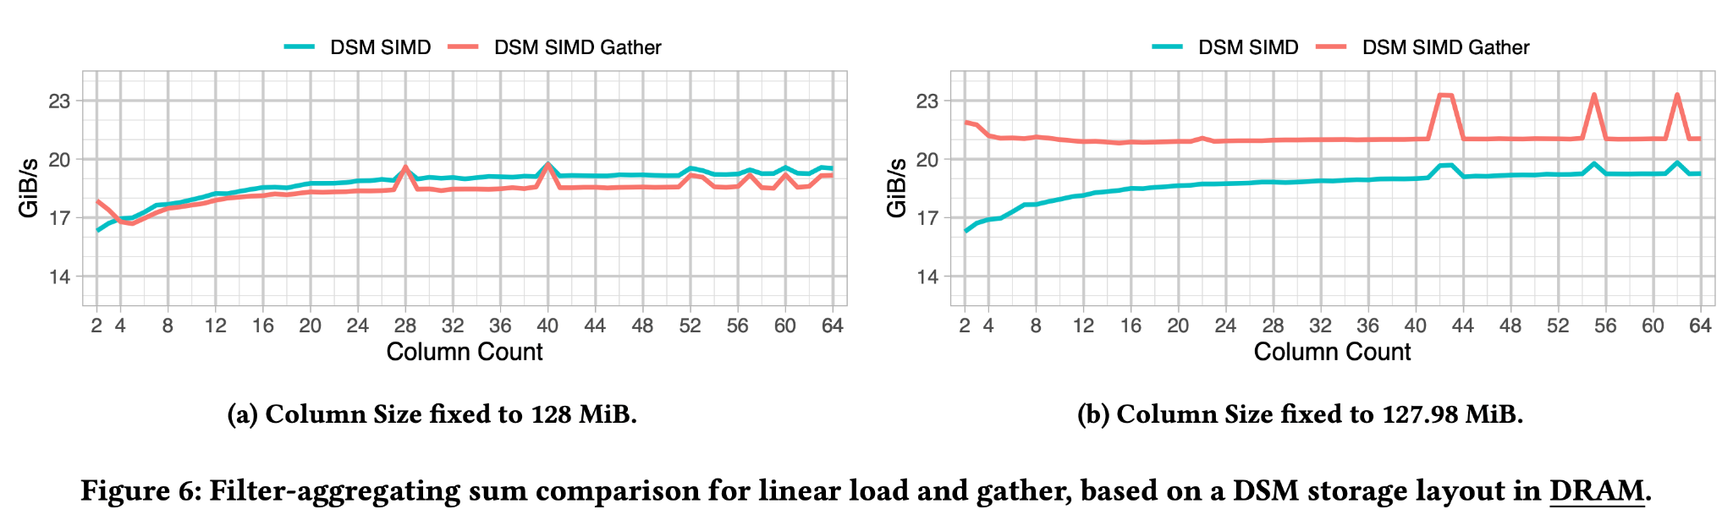
Column store Linear vs Gather Data Accesses
*DSM = Column store
Notes:
- To further analyze the efficiency of the two access patterns, they experimented by having a column size which is the size of the cache (figure a), and having a column size that is just under it (figure b).
In the first case, we can see that both approaches have similar efficiency, but with the linear slightly outperforming the gather.
In the second case, we see that while the linear access stayed the same as figure a, the gather has increased substantially.
To explain that we have to get a bit technical.

Slide 17
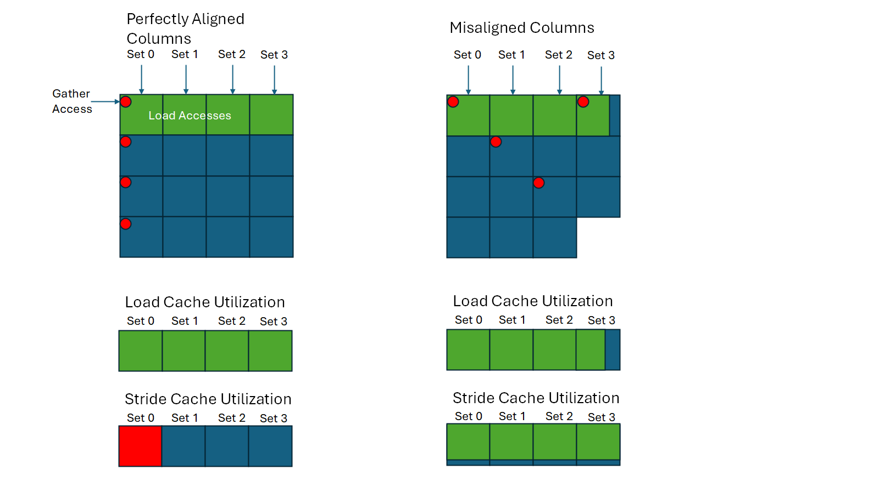
SIMD Linear vs. SIMD Gather Cache Utilization
Notes:
Suppose that this 2D array is the cache, each column represent a set.
Due to the way the cache is designed it can read data from different sets at the same time, but if we had to read all the data, we need from the same set it will do so serially.
When we have a linear access pattern the data will always be in different sets, utilizing the cache’s parallelism.
When we have a gather access pattern, if the columns are aligned perfectly each SIMD register will hit the same set, which doesn’t take the advantage of the cache’s parallelism.
But, when the columns are slightly misaligned like the figure b of previous slide, the data for a SIMD register will end up in different sets because of the cache’s hashing mechanism.
As we said, when the data is misaligned, gather access becomes better than linear. As we can see from this figure, when loading linearly the data in a SIMD register, one set will be utilized less than the others, cleating an imbalance. But the gather access will utilize all sets the same.

Slide 18
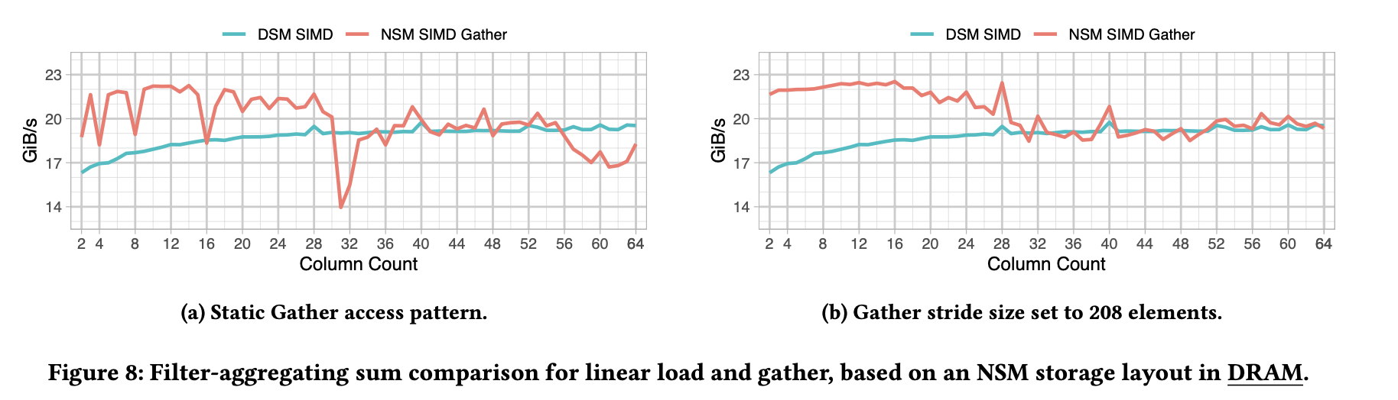
DSM (Column Store) linear vs NSM (Row Store) gather
NSM performance is better due to misaligned memory accesses, adjusting partition sizes improves performance, making nsm better than dsm
Notes:
- They also explored the problem of using Row-store data or NSM.
In their experiments they need all the columns to resolve a query.
Here they compare the column store linear access vs the row store gather access, and they show that row-store gather access outperforms the column store linear access because the extra columns create a misalignment in the cache that creates the same phenomenon we show in previous slide.

Slide 19
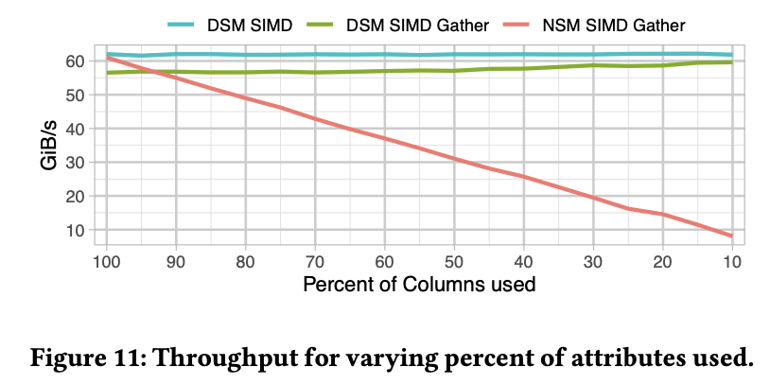
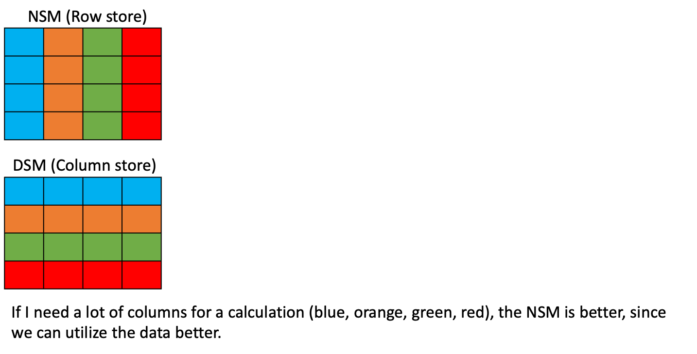
NSM vs. DSM
Notes:
Finally, they looked into what happens when we reduce the number of columns we need for a query.
When, column store is used the number of columns needed doesn’t affect the performance.
But when we have row-store gather access the performance drops linearly with the percentage of columns needed, because we have unused data in the cache.

Slide 20
Conclusion
Modern CPUs benefit from combined MIMD-SIMD execution.
A good memory access pattern can significantly improve performance.
Notes:
The conclusion for this work is that the integration of MIMD and SIMD for query processing can increase the bandwidth utilization.
A good memory access pattern can have a significant contribution to the performance increase.

Slide 21
Q&A
Thank you for your attention!
Questions?
Notes:
Questions?

