Slide 1

Beyond Relations: A Case for Elevating to the Entity-Relationship Abstraction by Amol Deshpande
University of Maryland College Park, USA
Overview of
Panayiotis Liotatis
University of Cyprus
EPL646

Slide 2
Abstract
Argument for Relational Database Management Systems (RDBMS) to move from the traditional relational model to the entity-relationship(ER) model as the primary data abstraction.
Modern relational databases lack logical data idependence → Just backend storage instead of being at the center of innovation.

Slide 3
Abstract
Introduction of ErbiumDB prototype. It has purpose of of addressing challenges in:
  Data abstraction
  Schema evolution
  Compliance
  Performance
Argument that adopting ER model can:
  Reduce schema complexity.
  Improve data governance.
  Reduce impedance mismatches between application logic and databases.
  Unclock better optimization opportunities

Slide 4
Why should change happen now?
Unwieldy and hard-to-understand schemas
  Often large, unintuitive, hard to understand, Hard to create and validate queries for a specific task.
  Insufficient information available regarding attributes; documentation(maintained externally) usually not up-to-date.
  “Schema decay”: Small changes overtime made to the original schema allow it to stray away from principled normal forms. Schema evolution is not supported natively, requiring users to write custom migration scripts → error prone and time consuming.

Slide 5
Why should change happen now?
Data governance and compliance
  Must comply with GDPR → More careful account of personal data
    This includes the deletion of User Data when requested(which is an entity-oriented operation), but…
    In normalized relational schemas, data of user is scattered across tables
  Today’s workarounds: External metadata managers
    Difficult to setup and maintain.
    Not well incorporated into the database or application code.

Slide 6
Why should change happen now?
Impedance mismatch
  Applications have entity-centric nature, but RDBs store data in tables
  Necessary to use Data Layer on top of the DB (normally API service or Object-Relational Mapper(ORM)).
    Duplication of effort.
    Mappings can be difficult to maintain and lead to data inconsistency
  Many databases (e.g., PostgreSQL + PostGraphile) can natively handle hierarchical queries, reducing the need for extra layers

Slide 7
Why should change happen now?
Embracing JSON and Property Graph Data Models.
  Much success of other data models (JSON, XML, etc.)
  Often used for same purpose as RDBs, or built as layers on top of them.
  Opinion: Unifying these models is pressing matter as it causes problems of:
    Duplication of effort
    Unessecary fragmentation
    Both user end and backend.

Slide 8
Why should change happen now?
Lack of logical independence
  RDBMSs optimize physical storage over performance.
    Lack logical independence, meaning schema decisions affect performance
  Schema design choices must be made early and are hard to change
    Can limit performance and scalability
    They should be automatically optimized based on workload
  Views can help but are complex to manage and optimize.
  The paper explores how better logical independence can boost database performance.

Slide 9
Why E/R?
Argument for the need to give more effort in developing and implementing advanced abstractions directly within database systems, not used just for schema-design.
Provides better structure than document and graph databases.

Slide 10
Advantages of E/R over other models
Supports hierarchical/nested data (like document databases).
Naturally handles relationships (document databases struggle with this)
More structured → reduces complexity for developers

Slide 11
Property Graphs & E/R Model
Property graph databases are like E/R models and can be mapped easily.
A graph database could even serve as a backend for an E/R-based system.

Slide 12
Past Failures to Move Beyond Relational Databases
Past attempts to move away from relational databases failed due to poor performance.
Main problem: Lack of effort in balancing abstraction and speed.
Today, ORMs, APIs, and document/graph databases show demand for higher-level abstractions.

Slide 13
Performance Concerns and Solutions
Arguments against higher-level models saying that are slower, but history shows better optimization can overcome this.
Online Transaction Processing (OLTP) Challenge: Handling complex objects & multi-table updates.
Online Analytical Processing (OLAP) Challenge: Handling inheritance hierarchies efficiently.
  A high volume of left outer joins when the E/R model is built on a relational database.
Possible solutions: New storage layouts & query processing techniques.

Slide 14
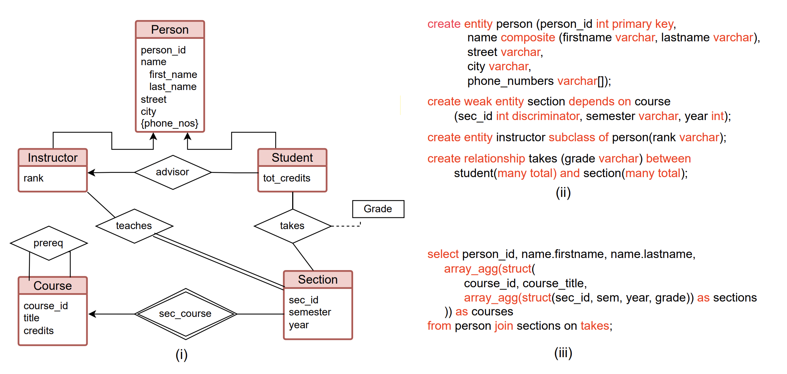
Example Design

Slide 15
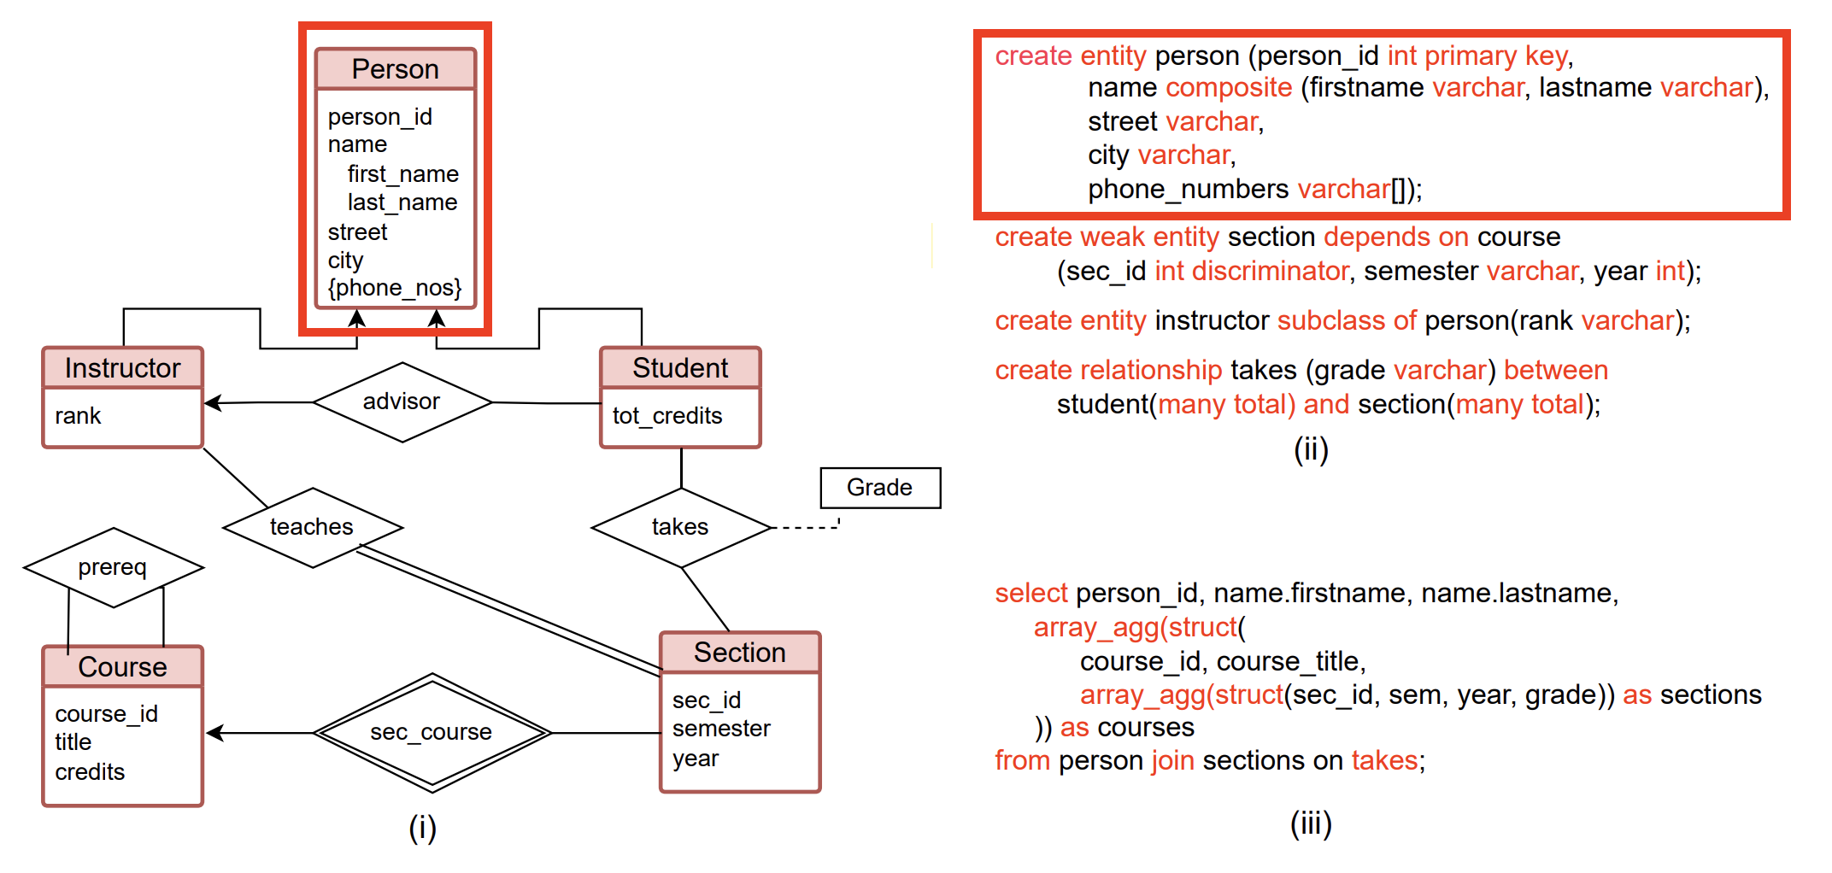
Example Design – Create Entity

Slide 16
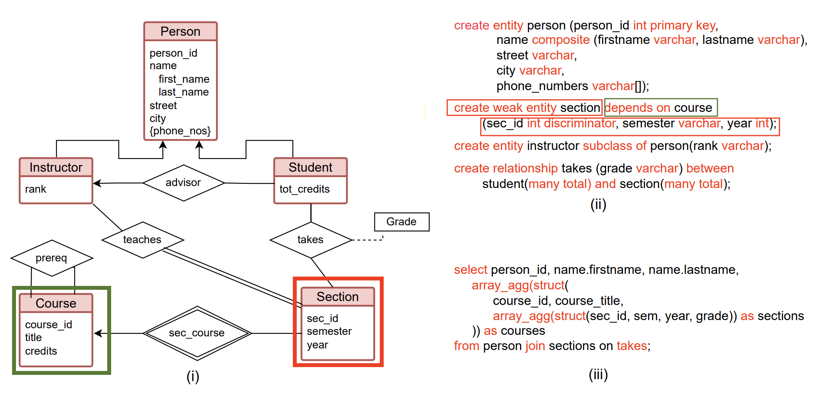
Example Design – Create weak entity

Slide 17
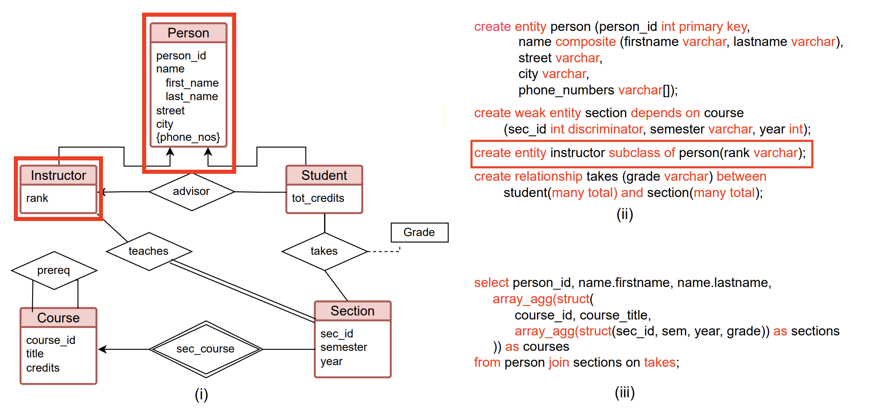
Example Design – Create subclass entity

Slide 18
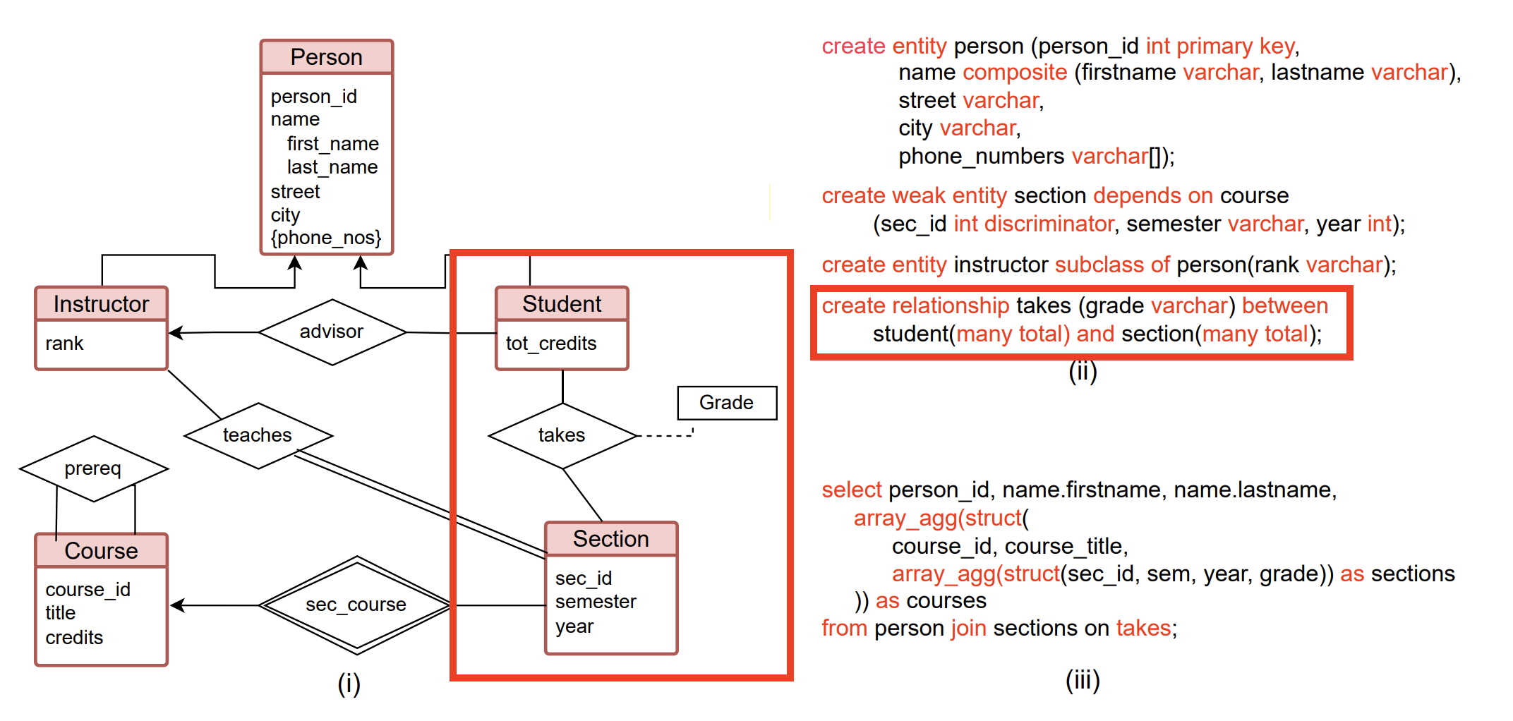
Example Design – Create Relationship

Slide 19
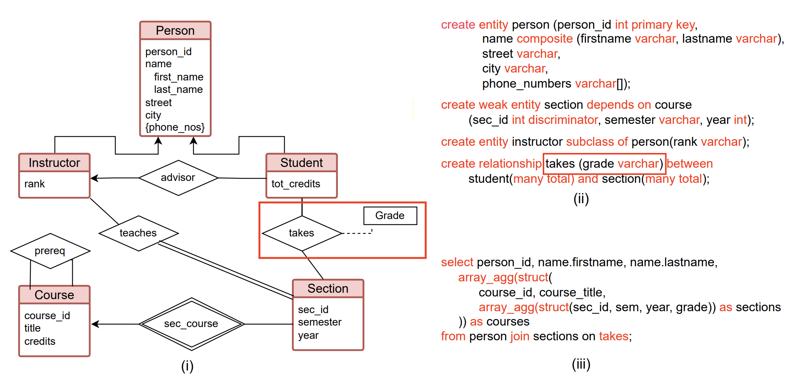
Example Design – Relationship name and attribute on relationship

Slide 20
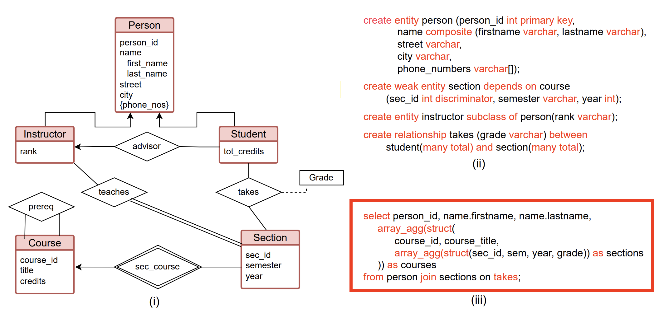
Example Design – Query Example

Slide 21
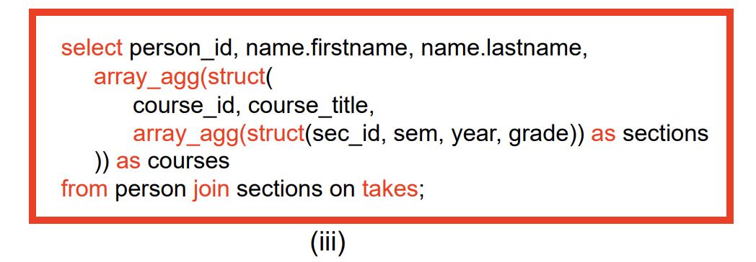
Query example explanation
Returns a list of (person id, first name, last name), as well as for each person, a list of courses (id, title) they have (using array_agg(struct(…)), and for each course a list of the sections(id, semester, year, grade) of the course.
Instead of flattening data into repeated rows, we store it logically in a structured, easy-to-read format.
This makes it more like how data is related in real life (people → courses → sections).
In short, this query organizes student data in a way that feels more natural and reduces complexity

Slide 22
Schema Evolution
Key Motivation
Prior research describes how schemas become complex, denormalized, and drift away from the original E/R model.
It is argued that adopting a higher-level data model can at least slow down database deterioration.

Slide 23
Example of difference during schema changes
  Switch an attribute from single valued to multi-valued.
  Normalized RDB changes:
    Move attribute to a separate table
    Modify any queries accessing it with additional join
  E/R Model changes:
    Minor change in the schema
    Small change in queries (e.g., select person_id, city → select person_id, unnest(city)).

Slide 24
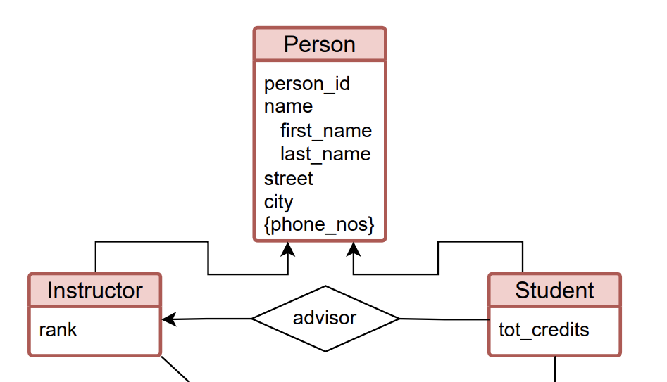
Defining class hierarchies in E/R
Major advantage: ability to define class hierarchies
Choose between specialization: total or partial, or overlapping or disjoint.
This decision needs to be made early.
A person IS-A student or Instructor

Slide 25
Schema changes are complex
Typically require complex data migration.
Often handled by the application layers, since DBs don’t natively support this.
Plan for future work to explore how changes can be supported natively in DB, as well as versioning to experiment with changes and roll back when needed.

Slide 26
Mapping to Physical Representation
Mentions previous works on this and problems that appear with those approaches.
Goal: Find best way to store data represented in E/R while ensuring that:
  Data must be recoverable (Retrieve stored data back to its original entities/relationships)
  CRUD operations must work efficiently (Changes in the data should correctly update in the mapped storage).

Slide 27
Mapping to Physical Representation
Three Storage Approaches
  Tables in First normal form (composite data are allowed but no multi-values).
  Hierarchical structures with a pre-defined schema
    Supports multi-valued attributes (arrays), including nested arrays within composite types.
    RDBs not optimised for this, columnar storage like Parquet can support read-only efficiently for such data. (Updates are harder)
  Multi-relational compressed (factorized) representations.
    Stores multiple related tables together compactly using physical pointers instead of joins.
    Reduces data duplication and speeds up aggregations and queries.
    But, works best when relationships are nearly one-to-one (low connectivity).

Slide 28
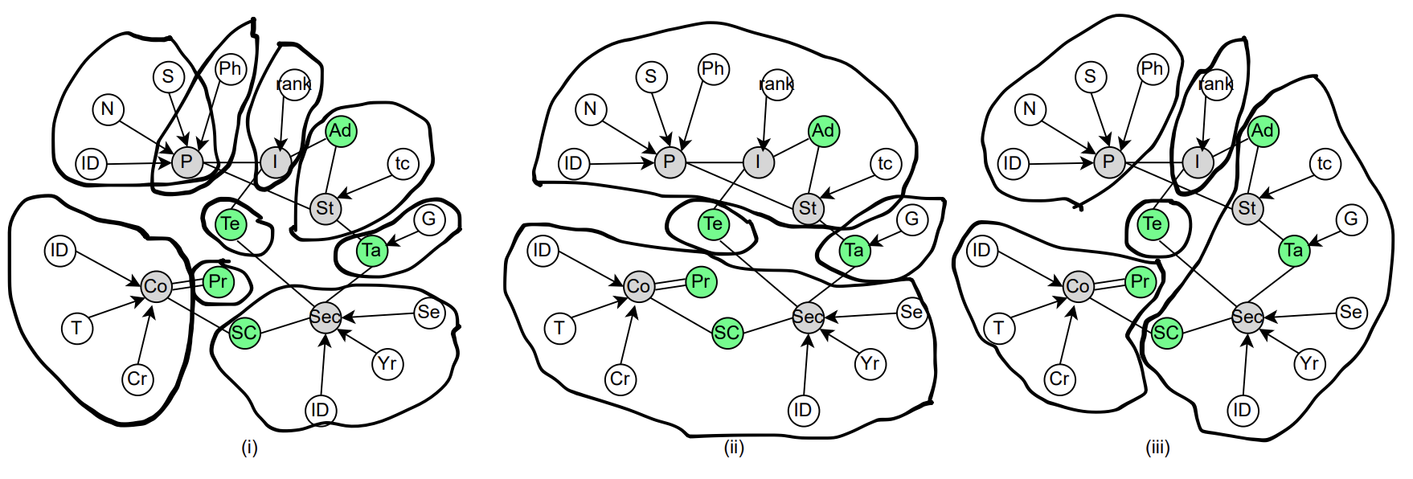
Explore Possible Mappings
Interpret the E/R model as a graph, where entities, relationships, and attributes are represented as individual nodes.
The mapping to physical storage can be visualized as clusters forming sub-graphs.

Slide 29
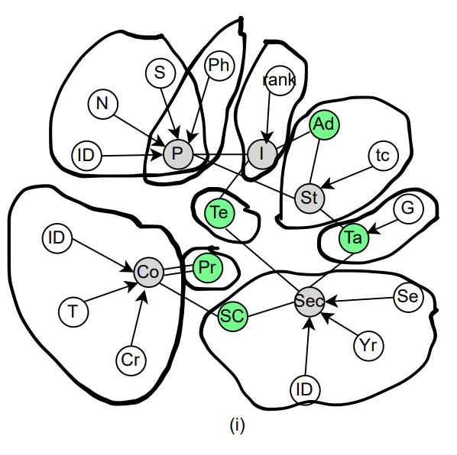
First Mapping
Fully normalized
Each entity is assigned its own table.
Many-to-one relationships are merged into the "many" side.
Many-to-many relationships are stored in a separate table (e.g., the student-section relationship).
Green: Relationship
Gray: Entity
White: Attribute

Slide 30
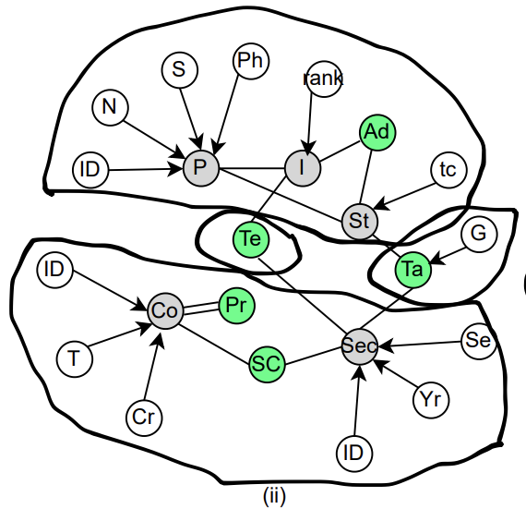
Second Mapping
Minimizes the required data structures.
Person and its subclasses are merged into a single table.
Use of array to store multi-valued attribute.
Move Section(weak entity) into Course
Result:
  Reduces number of Joins
  Require use of unnest operation, not very optimized.
Green: Relationship
Gray: Entity
White: Attribute

Slide 31
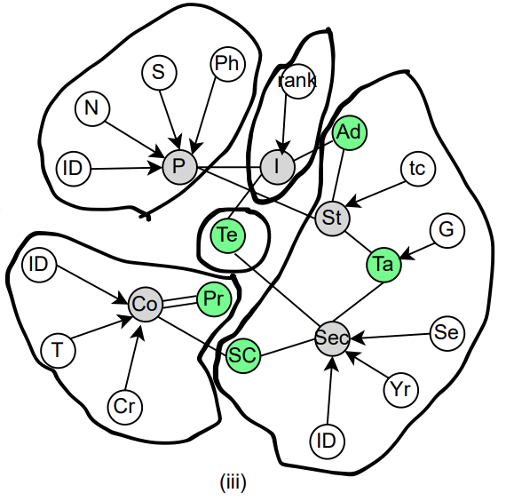
Third Mapping
Two entities in a many-to-many relationship are stored within a single data structure.
Implemented using PostgreSQL.
  Data duplication
  Higher cost of insert, updates, deletes
  Goal: research alternative representations
Green: Relationship
Gray: Entity
White: Attribute

Slide 32
Key researach challenges on Mapping
Determine the optimal mapping for a given schema, dataset, and query workload.
Develop methods to automate the generation of these mappings efficiently.
This is part of future work.
  Remember: must satisfy that mapping is reversable and handles CRUD operations efficiently.

Slide 33
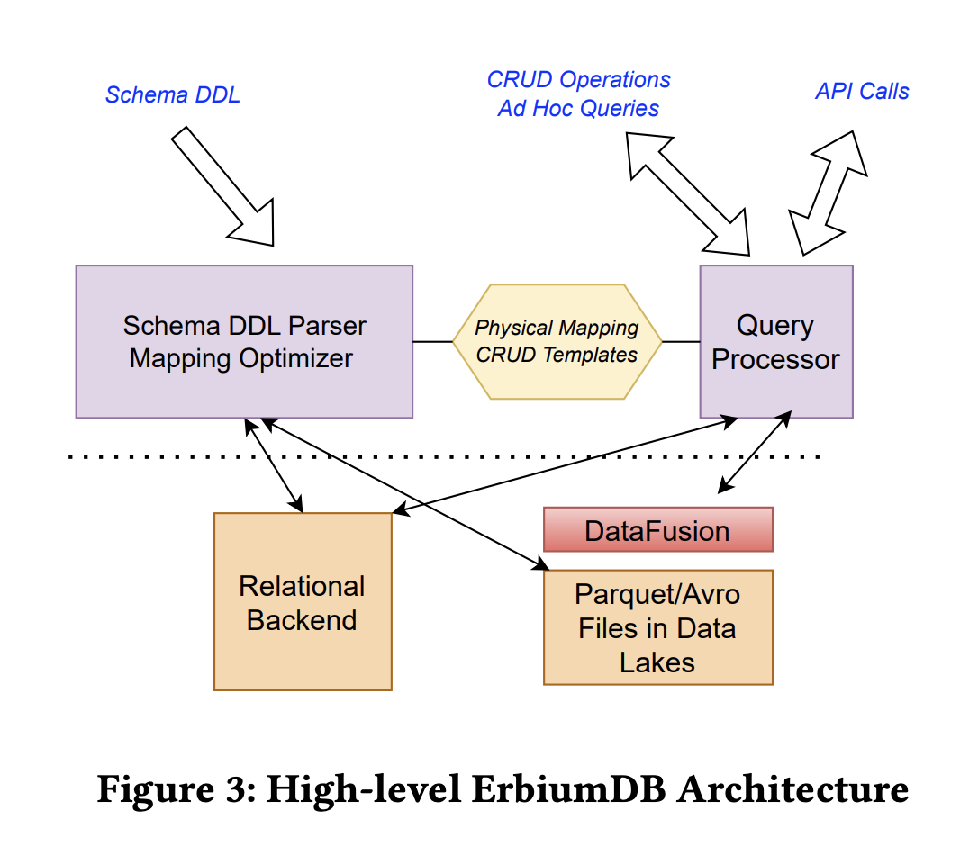
Prototype: ErbiumDB
Proof-of-concept prototype system.
Use to explore research questions raised.
Written in python.
Developed as a layer on top of PostgreSQL, with the aim of expanding support to other backends like Apache DataFusion.
Mapping is kept in a JSON object in database and read into memory on initialization time.

Slide 34
Prototype: ErbiumDB
DDL does most heavy work:
  Generates an E/R graph from entity and relationship creation statements.
  Continuously updates the graph as the schema evolves.

Slide 35
Experimental Results on E/R Model Mappings
Experimented with: Multi-Valued Attributes, Type Hierarchy, Folding Weak Entities into Composite Types, Pre-Computed Joins.
Different storage layouts affect performance significantly, highlighting trade-offs.
PostgreSQL has optimizations missing for nested structures, suggesting a need for better query execution techniques.
The best storage model depends on the workload. Logical independence allows flexibility in choosing the best representation.

Slide 36
Conclusion
Databases have improved internally, but not for users
  Advances in storage & query execution exist, but user-facing database models remain outdated.
  Industry has patched this gap with ORMs, APIs, and external layers.
The E/R Model is a Strong Middle Ground.
  It raises abstraction while maintaining simplicity & usability.
  Enhancing logical independence inside databases unlocks new optimizations.

