Slide 1

Predicate Caching
Predicate Caching: Query-Driven Secondary Indexing for Cloud Data Warehouses
Schmidt, Tobias & Kipf, Andreas & Horn, Dominik & Saxena, Gaurav & Kraska, Tim. (2024).
347-359. 10.1145/3626246.3653395.
Stylianos Vassiliou
Panteleimonas Chatzimiltis
Notes:
A new caching technique of cloud data warehouses for query ooptimizaiton.

Slide 2
Presentation Outline
Caching Background
Motivation
Predicate Caching
Evaluation
Conclusion

Slide 3
Presentation Outline
Caching Background
Motivation
Predicate Caching
Evaluation
Conclusion

Slide 4
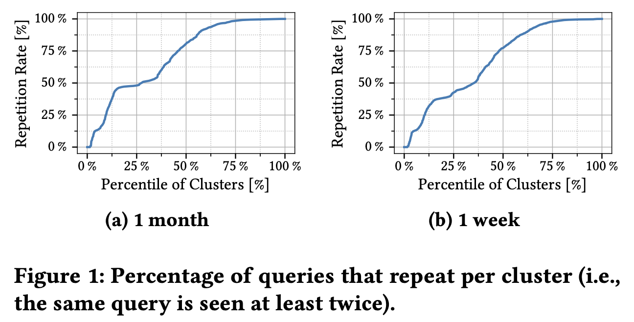
Caching Techniques in Cloud Data Warehouses
Cloud data warehouses often experience repeating query patterns – a key opportunity to improve performance through caching!
Notes:
Cloud data warehouses - repeating queries…
Improve performance – caching
50% clusters have repetition rate of 75% after a month

Slide 5
Caching Techniques in Cloud Data Warehouses
Design Objectives:
  Low build cost.
  Low maintenance cost.
  High reuse potential.
  Fast lookup performance.
Now we will go through some of the caching techniques …
Notes:
Design objectives for caching in cloud data warehouses

Slide 6
Result Caching
Stores results of recently executed queries at the cluster node.
If the same query is submitted again with the same dataset, the result is returned instantly from the cache.
Notes:
Stores the results of executed queries
Same query example -> instanty returned.

Slide 7


Result Caching
Advantages:
Simple – No changes needed to database.
Low overhead – No significant build cost.
Performance – Cache hits return results within milliseconds instead of minutes!
Limitations:
Low hit rate
  Requirement of identical query text and unchanged data
  High frequency of data-modifying operators (e.g., inserts, copies)
Amazon study:
  15% of clusters had a hit rate over 50%.
  >80% hit rate when no updates occur.
  Hit rate drops sharply as update frequency increases.
Notes:
Very simple, low overhead – low build cost, high performance, cache hits return results in milliseconds instead of minutes
But,
Low hit rate, identical queries and unchanged data are rare.
High frequency of data-modifying operators (inserts, deletes, updates)
Amazon study showed that only 15% of clusters had a hit rate over 50% and 80% when no updates occur…
Hit rate drops significantly after as update frequency increases.

Slide 8
Materialized Views
Materialized views are for repeating query templates.
Amazon Redshift identifies similar queries and reuses precomputed sub-plans instead of executing from scratch.
Key advantage over Result Caching:
  More flexible matching by generalizing query patterns.
Notes:
Materialized views are for repeating query templates.
It basically stores the results, of the frequent sub-plans for queries. That are frequently executed by multiple queries.
Think of a sub-plan.
Key advantage over the result caching is:
Not only save the result of a query, but also the sub-results until we reach the final solution.

Slide 9
Materialized Views
Advantages:
Matches a broader range of queries than exact-match result caching.
Higher flexibility.
Limitations:
High maintenance overhead:
  Views must be refreshed on data changes.
  Insert/delete/update can trigger multiple refreshes.
Expected gain must outweigh cost – careful tuning required.
Bottom Line:
MVs offer higher flexibility but come with greater complexity and overhead compared to result caching.
Notes:
helps broader range of queries, than exact match.
Higher flexibility.
But,
Views must be rewritten on data changes, after inster, deletes, updates.
-this is very costly, and someone must think carefully, if the gain of MV outwight their cost.. Careful tunning might be required.
The bottom line of mvs is that they offer higher flexibility than result cache, but with higher complexity and overhead.

Slide 10
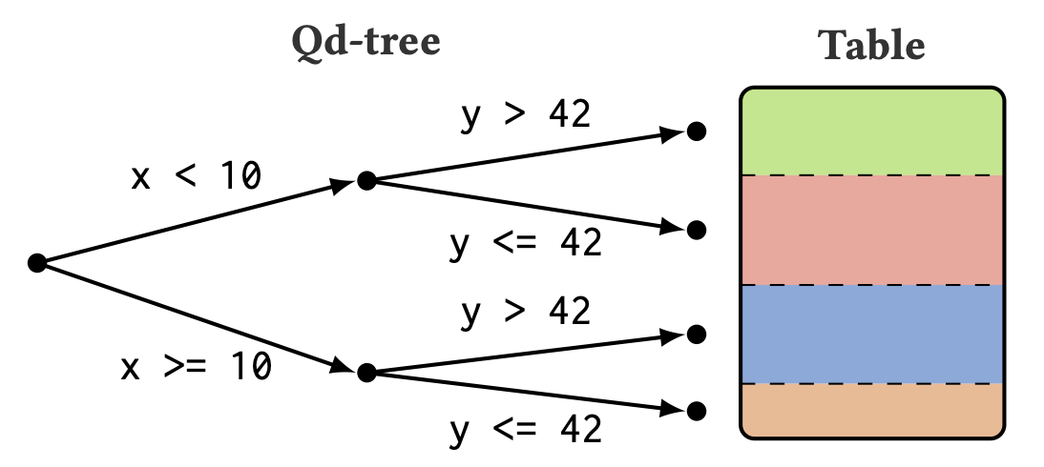
Query-Driven Data Layouts (Qd-tree)
Caching technique that reorganizes table data based on repeating filter conditions in queries.
Example:
  If many queries filter on “x < 10” and ”y > 42”, then table is split:
    One part matches the filters
    Others are skipped during scans.
Notes:
Qd-tree is a chaching technique that reorganizes table data based on repeating filter conditions.
For example if many queries use same filters, then qd-trees might be very useful. Since we skip a lot of unneeded scans of the data.
As we can see in the example we split the data of the table according to the filters used.

Slide 11
Query-Driven Data Layouts (Qd-tree)
Advantages:
Speeds up queries by skipping unneeded data.
Good for cloud systems (reduces data read from storage)
Easy to insert/delete data.
Limitations:
Slow to build.
Hard to adapt if the query patterns change.
Best for stable, repeating workloads.
Bottom Line:
Qd-tree improves performance using data layout – but it’s less flexible than query-level caching.
Notes:
Speeds up queries by skipping unneeded data scans.
Reduction of data reads, is very important for cloud systems - which is very slow.
We can easily instert or delete data.
But,
It can be very slow to build.
If we deside to change the query filters, lets sayy 53 from previous slide instead of..
Then it will have overhead, it is good for stable repeating workloads. That do not change filters for example.
The bottom line is that they improve performance by using their data layout but they are less flexible than the query level caching techniques.

Slide 12
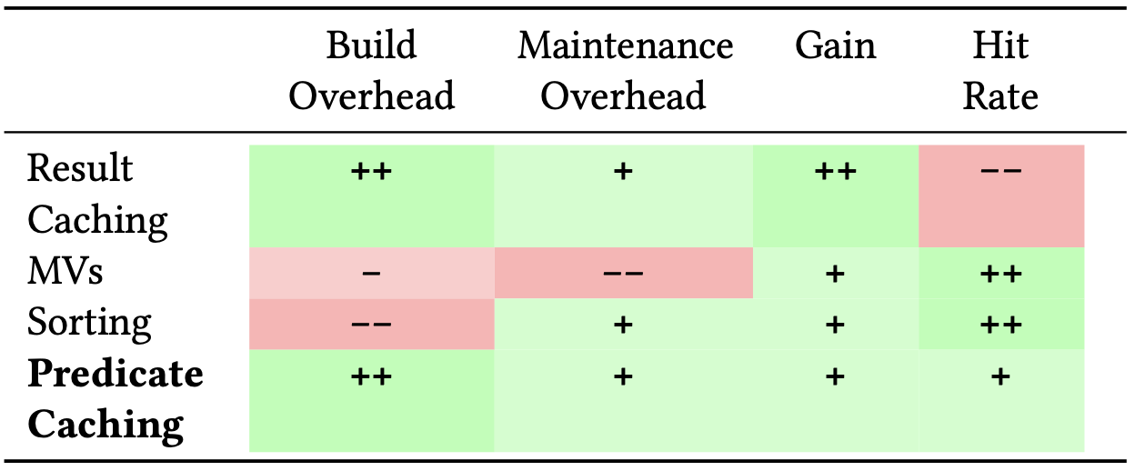
Comparison of Different Caching Techniques
(Qd-tree)
Notes:
This shows the comparison of the approaches and the proposed approach that we will soon introduce.

Slide 13
Presentation Outline
Caching Background
Motivation
Predicate Caching
Evaluation
Conclusion
Notes:
Their motivation is that. .

Slide 14
Motivation
Why a new caching Technique is needed?
Goal | Result Cache | MVs | Qd-Tree
Online | ❌ | ❌ | ✅
Lightweight | ✅ | ❌ | ❌
On-the-fly | ✅ | ❌ | ❌
Data-independent | ❌ | ❌ | ✅
Design Goals of Predicate Cache:
✅ Online: Stays valid with minimal maintenance
✅ Lightweight: Avoids time-expensive synchronization
✅ On-the-fly: Built during query execution
✅ Data-independent: Not invalidated by table updates.
Notes:
Their motivation is that they need a caching technique that fills the gaps of the prior techniques, since they all have some limitations such as.
Low maintenance cost, avoid time expensive synchorization, can build caching during query execution, and good after table updates.

Slide 15
Presentation Outline
Caching Background
Motivation
Predicate Caching
Evaluation
Conclusion

Slide 16
Predicate Cache Overview
How it works:
  Hash Tables: Stores predicates in memory as hashable strings.
Optimization:
  Cost-based decisions on which predicates to cache based on selectivity and repetitiveness.
Tested and seamlessly implementable to Amazon Redshift
Notes:
Predicate caching has hash tables that stores the data as hashable strings.
It is up to the optimizer to decide which predicates are to be kept, based of how selective and repeatable they are
It was tested on Amazon Redshift and it can be integrated on it very well.

Slide 17
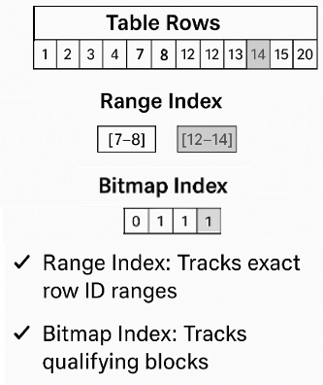
Predicate Cache Variants
Range Index:
  Caches row ranges where predicates match.
  May result in false positives, which are filtered during scan.
Bitmap Index:
  Uses a bitmap to represent blocks of data.
  Faster to construct but less precise.
Which to Use?
  Range Index: More precise, but uses more space.
  Bitmap Index: Faster, but less precise.
Notes:
Predicate caching has 2 variations. Range index and Bitmap index
Range index keeps the row ranges were there are matches. It is resilient to false positives, as they can be filtered at future scans
Bitmap indez uses bits to represent data blocks and mark the ones with matches. It is faster to construct, but can have many irrelevant data
In general, Range index is more precise bat need more space, while Bitmaps are less precise

Slide 18
Predicate Caching in Action
Query: Count all Region
Filters: Region = "EU"
Row index | Region
0 | US
1 | EU
2 | EU
3 | US
4 | US
5 | EU
6 | EU
7 | EU
8 | US
Example Query:
  Query: Select count(*) from Region_T
  Filters:
    Region = EU
How it works (Caches Filtered Data ):
  Stores qualifying rows for each predicate: [1-2],[5-7]
  Next time a similar query is executed, it skips unqualified rows.
Notes:
Here's an example. We have the table regions, and we want to count the rows with EU. First it filters them and the predicate keeps the ranges 1-2 and 5-7.
The query will then finish normally and the next time we have the same filters, it will skip the irrelevant ranges

Slide 19
Predicate Cache on Data Modifications
Cache entries remain valid even when data is inserted, deleted, or updated.
Inserts:
New tuples added at the end.
Cached row ranges stay valid.
New rows scanned normally and incrementally added to the cache.
Deletes:
Uses multi-version concurrency control.
Deleted rows become invisible, but ranges stay valid.
Updates:
Old version marked deleted, new version added.
Cached predicates remain unaffected.
Bottom Line:
Predicate caching handles dynamic workloads efficiently without frequent invalidations.
Notes:
Predicate caching is resilient to data changes. On inserts, new tuples are appended at the end, and only need to keep up to what row the data are cached. At the next scan, the new entries can be filtered out
On deletes and updates, it uses multi-version concurrency control. Deleted rows are kept as hidden, unit being vacuumed, so it stays valid, while updates delete the old row and insert a new at the end.
This combines the insert and delete mechanism.

Slide 20
Predicate caching across formats
Works with data lakes like Delta Lake and Iceberg.
Supports open formats like Parquet, ORC, and CSV
Requirements for Use:
  Stable row identifiers (global row IDs or file offsets).
  Infrequent row reordering (to prevent cache invalidation).
  Detectable table changes (for correct invalidation).
  Format supports fine-grained reads (to benefit from skipping).
Notes:
It works with data lakes like Delta lake and Iceberg, as well as with open source formats like Parquet
To use it, the format need to have the following characteristics.
It needs stable row identifiers like IDs,
Infrequent row reorganisations to limit cache invalitations,
To be able to detect table changes to see if we need to invalitate any cache
and to support fine grained reads to benefit from row skipping

Slide 21
Presentation Outline
Caching Background
Motivation
Predicate Caching
Evaluation
Conclusion

Slide 22
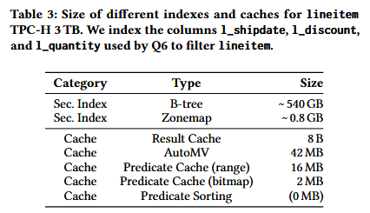
Memory Consumption
Caching offers massive memory footprint reduction over indexes
Predicate caching has different sizes depending on implementation
Q6 had a single response, so Result Caching is small, but ultimatly it depends on the query
Predicate Sorting saves memory but requires full table reorganization
Notes:
Here we see the memory consumption
Caching needs a lot less memory than indexing, and predicate has different requirement based on implementation.
In the specific query, it had only 1 value as a result, and that’s why it is so little, but in general, it depends on the query.
Finaly, sorting has no extra memory needs, but it needs to reorganise the original data

Slide 23
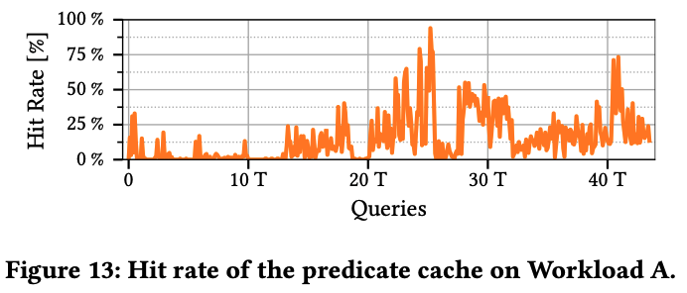
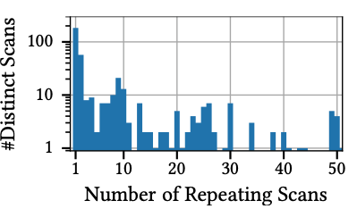
Hit Rate
Initial low Hit Rate
  Cache starts empty
Significant increase in hit rate after 15000 queries
Reduced number of distinct scans over time.
Notes:
In initially, the cache starts empty, and so it has no hits, but as the cache gets filled, the hits drastically increase.
At the same time, the scans on the original data decrease.

Slide 24
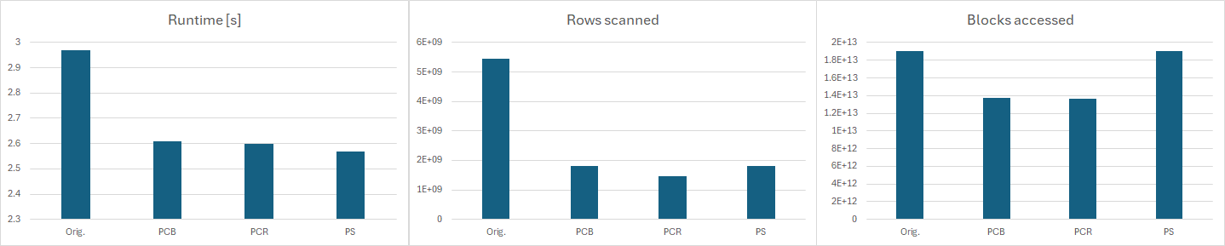
Query Performance
10% performance improvement
Scanned rows 4x less
Accessed Blocks reduced by 30%
Run time is mostly corelated with block reduction
Notes:
Finally we compare the performance of not using caching, using the 2 predicate cache variations, and the sorting approach.
We see that it had a 10% performance improvement, despite scanning 4 times less rows.
That is because it corelates more on the decrease of accessed blocks, that fell by only 30%

Slide 25
Presentation Outline
Caching Background
Motivation
Predicate Caching
Evaluation
Conclusion

Slide 26
Conclusion
Caching helps speed up queries in cloud data warehouses.
Existing methods (Result Cache, MVs, Qd-Trees) have limits.
Predicate Caching is:
  Fast and simple
  Stays valid even if data changes
  Up to 10x faster queries – even with frequent updates!
Notes:
To conclude this presentation, we saw that caching is very important to speed up especially repeating queries for data warehouses.
Existing methos have limitations and imperfections as we saw.. The proposed technique predicate caching tried to fill the gaps, by being simple and fast, stays valid even after data changes, and it showed up to 10x faster queries on Amazon Redshift even with frequent updates.

Slide 27
Predicate Caching
Predicate Caching: Query-Driven Secondary Indexing for Cloud Data Warehouses
Schmidt, Tobias & Kipf, Andreas & Horn, Dominik & Saxena, Gaurav & Kraska, Tim. (2024).
347-359. 10.1145/3626246.3653395.
Stylianos Vassiliou
Panteleimonas Chatzimiltis
Notes:
A new caching technique of cloud data warehouses for query ooptimizaiton.

