Slide 1

COSMO: A Large-Scale E-commerce Common Sense Knowledge Generation and Serving System at Amazon
EPL646: Advanced Topics in Databases
Changlong Yu, Xin Liu, Jefferson Maia, Yang Li, Tianyu Cao, Yifan Gao, Yangqiu Song, Rahul Goutam, Haiyang Zhang, Bing Yin, Zheng Li. 2024. COSMO: A Large-Scale E-commerce Common Sense Knowledge Generation and Serving System at Amazon. In SIGMOD-Companion ’24 (pp. 13 pages). https://doi.org/10.1145/3626246.3653398.
By Panayiotis Liotatis: pan01612@gmail.com

Slide 2

The E-commerce Semantic Gap
Data Rich, but knowledge poor
E-commerce platforms possess vast quantities of data: product catalogues, user activity logs, etc.
However, effectively capturing the semantics of user intent remains a challenge.
Traditional approaches often fail to model the implicit commonsense knowledge that informs user actions.

Slide 3
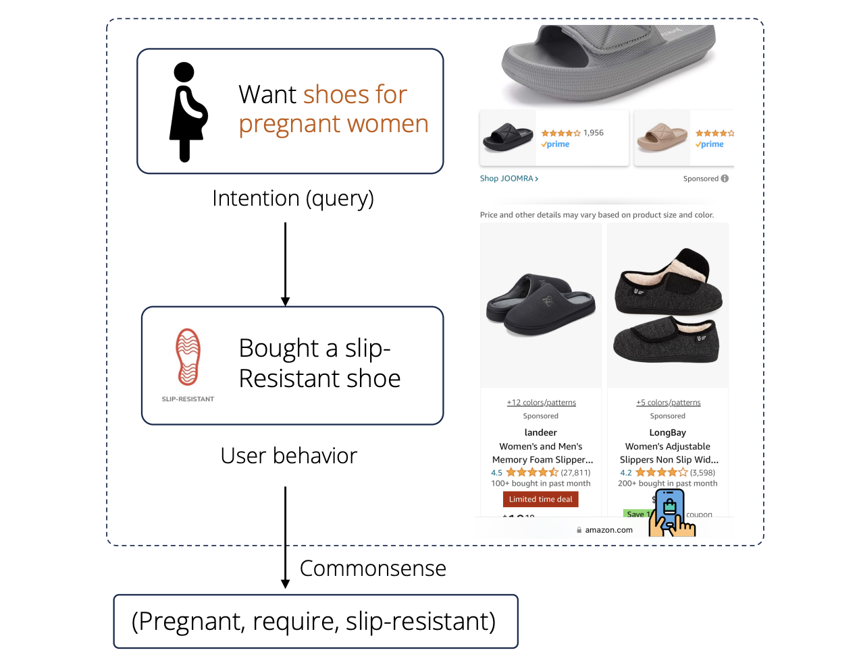
Example:
Mining implicit commonsense knowledge from e-commerce user behavior

Slide 4
COSMO: Knowledge-Driven E-commerce
Leveraging LLMs for User-Centric Commonsense
COSMO: System designed to mine and represent user-centric commonsense knowledge.
Constructs knowledge graphs to explicitly model user intentions and their relationships to products and behaviours.
Key components include:
  Distilling seed knowledge from LLMs
  Refinement via human-in-the-loop feedback
  Instruction tuning for efficient knowledge generation

Slide 5
Related work
E-commerce Knowledge Graphs
Existing KGs focus on factual product knowledge (isA, authorOf).
Lack user intention and commonsense knowledge ("apple product fans", "attend weddings").
COSMO goes beyond factual knowledge to model user intentions.

Slide 6
Related work
Instruction-Followed LMs
Vanilla LMs lack alignment with human preferences (unfaithful, biased outputs).
Instruction tuning improves LM behaviour (helpfulness, truthfulness).
COSMO uses instruction tuning to generate better e-commerce commonsense knowledge.

Slide 7
Related work
FolkScope
FolkScope distils intention knowledge but has limited scope.
COSMO extends FolkScope to more domains and user behaviour types.

Slide 8
Related work
How they differ
"We are the first to propose an effective KG construction pipeline from LLMs and massive user intentional behaviours."

Slide 9
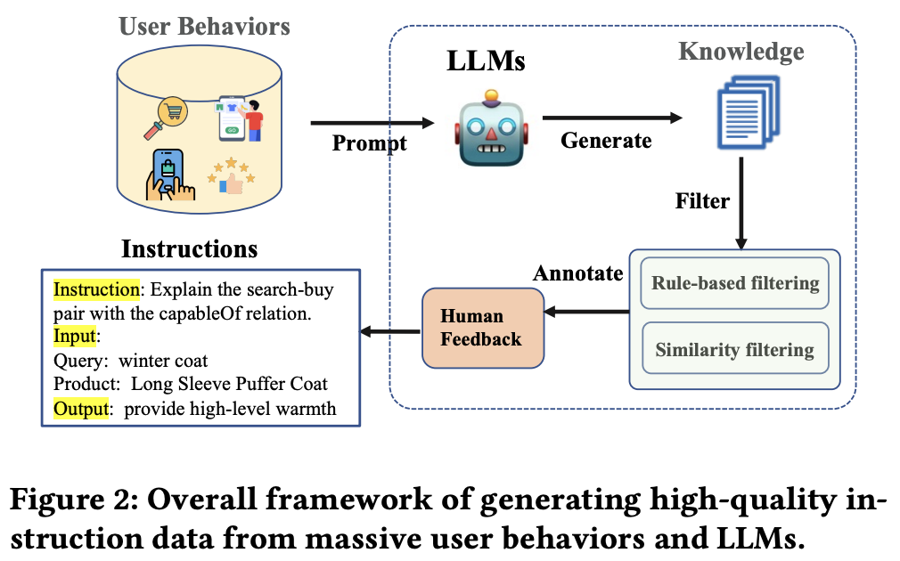
Proposed framework
Preliminary - Overview of COSMO Knowledge Generation pipeline
User behaviours
Produce huge amount of behaviour logs

Slide 10
Proposed framework
Preliminary - Overview of COSMO Knowledge Generation pipeline
User behaviours
Produce huge amount of behaviour logs
search – buy & co-buy
Search-buy behaviour: Query-product pair (q, p)
Co-buy behaviour: Co-purchased products pair (p1, p2)

Slide 11
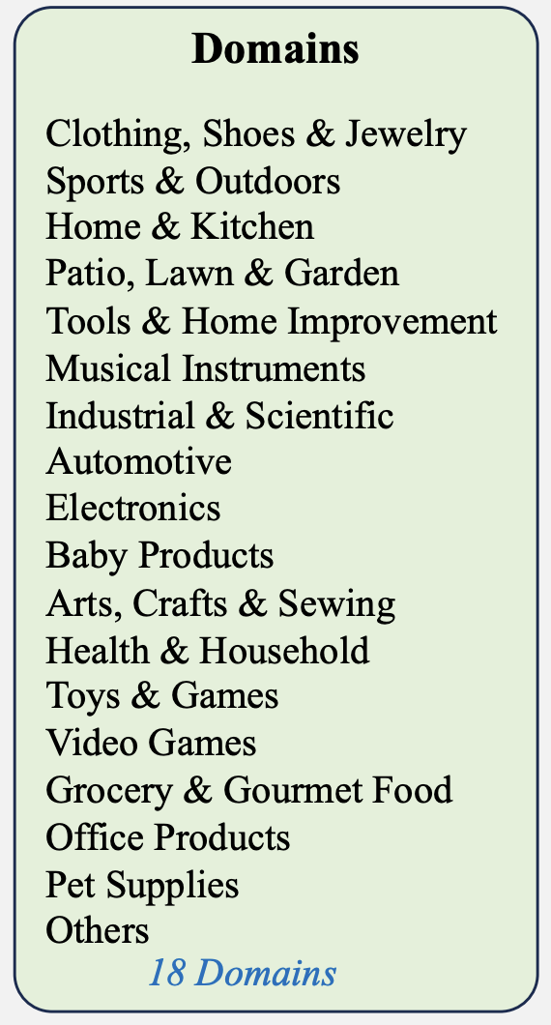
Proposed framework
Preliminary - Overview of COSMO Knowledge Generation pipeline
User behaviours
Every product can be categorised into one main domain d

Slide 12
Proposed framework
Preliminary - Overview of COSMO Knowledge Generation pipeline
Commonsense Knowledge
Place relation-aware prompts to LLMs to describe the user behaviour
  Create a knowledge candidate
Knowledge candidate represented as a triple
  (h, r, t) where,
  h: user behaviour, r: relation, t: tail
Example: user behaviour: “customers bought camera case and screen protector glass together because they are capable of providing protection for camera”
Tail t: “provide protection for camera”,
under the relation r capableOf

Slide 13
Proposed framework
Preliminary - Overview of COSMO Knowledge Generation pipeline
Commonsense Knowledge
Proposal for data-driven relation discovery from large-scale generations to satisfy e-commerce scenarios
Begin from four seed relations:
  usedFor, capableOf, isA, cause
    Previous work shows that these give high-quality knowledge.

Slide 14
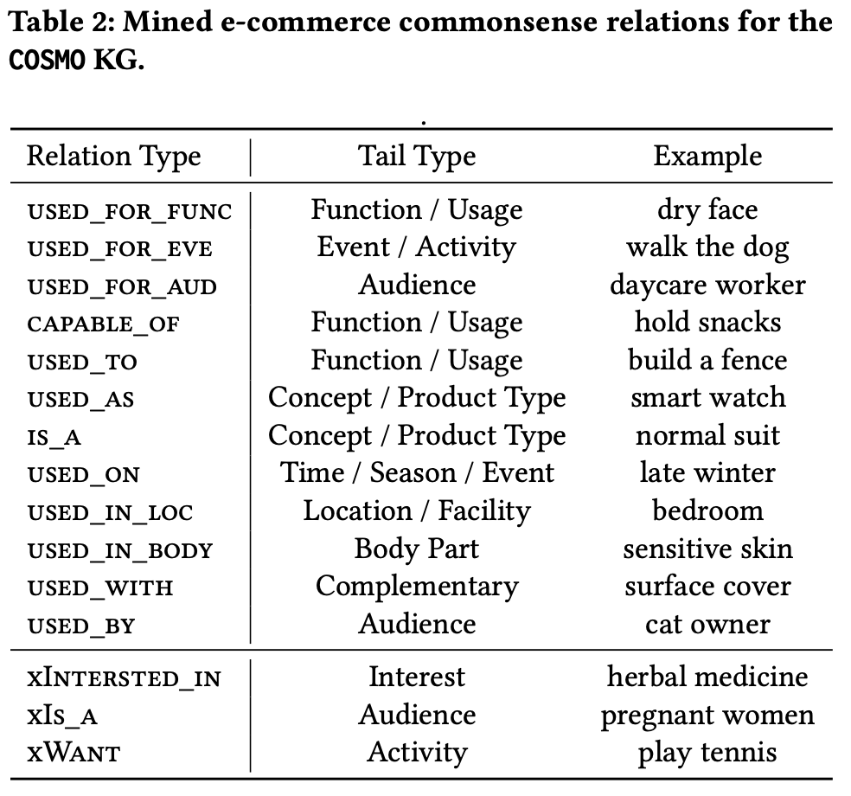
Proposed framework
Preliminary - Overview of COSMO Knowledge Generation pipeline
Commonsense Knowledge
Example of mined knowledge types and their corresponding tail types

Slide 15
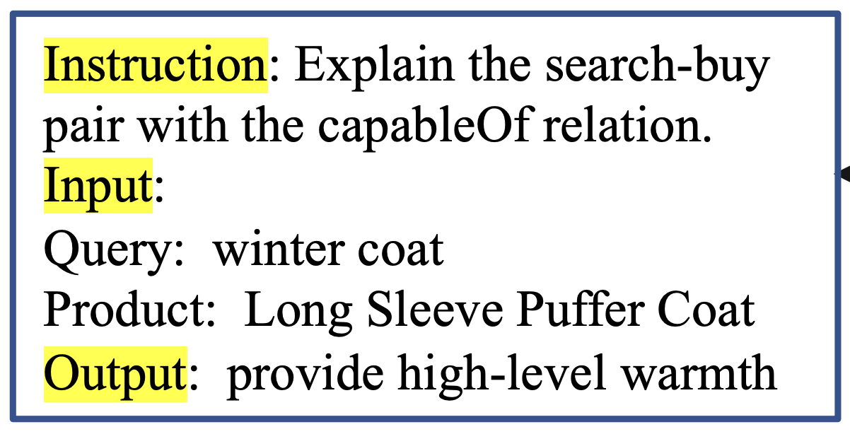
Proposed framework
Preliminary - Overview of COSMO Knowledge Generation pipeline
Instruction Data
Set of instructions I_{t}.
  Each define task t in natural language (see figure)
Task Structure: Every task includes input-output pairs. For commonsense generation:
  Input: user behaviour (p1, p2) or (q, p)
  Output: knowledge tail t.
Knowledge Quality (h, r, t): Measured by plausibility and typicality.
  Assessed by human annotators.
  High-typicality knowledge is preferred.
Enhancement: Helper tasks are added to improve e-commerce awareness, knowledge generalization, and online serving of instruction-finetuned models.

Slide 16
Knowledge generation
Proposed Framework
User Behaviour Sampling
Conduct fine-grained sampling to generate diverse and high-quality knowledge
  Only need subset of the vast amount of user behaviour, that is most likely to reveal user intentions.
First Product Sampling then Behaviour Pair Sampling

Slide 17
Knowledge generation
Proposed Framework
User Behaviour Sampling
Product Sampling
Cover most common popular categories (browse nodes)
Select top tier products with larger behaviour interactions
Label: Category type (domains), product type (>1000, what product is e.g. umbrella, chair etc.)

Slide 18
Knowledge generation
Proposed Framework
User Behaviour Sampling
Behaviour Pair Sampling
Co-buy pair sampling
  Each co-buy pair must include at least one selected product
  Cross-check with the product type of sampled pairs
  Remove random co-purchases and avoid duplicated sampling
  Some heuristic rules are applied
Search-buy pair sampling
  Set threashholds for purchase rate and click rate (empirically)
  Consideration of specificity of query (broad or specific)
    Knowledge from broad query is more valuable

Slide 19
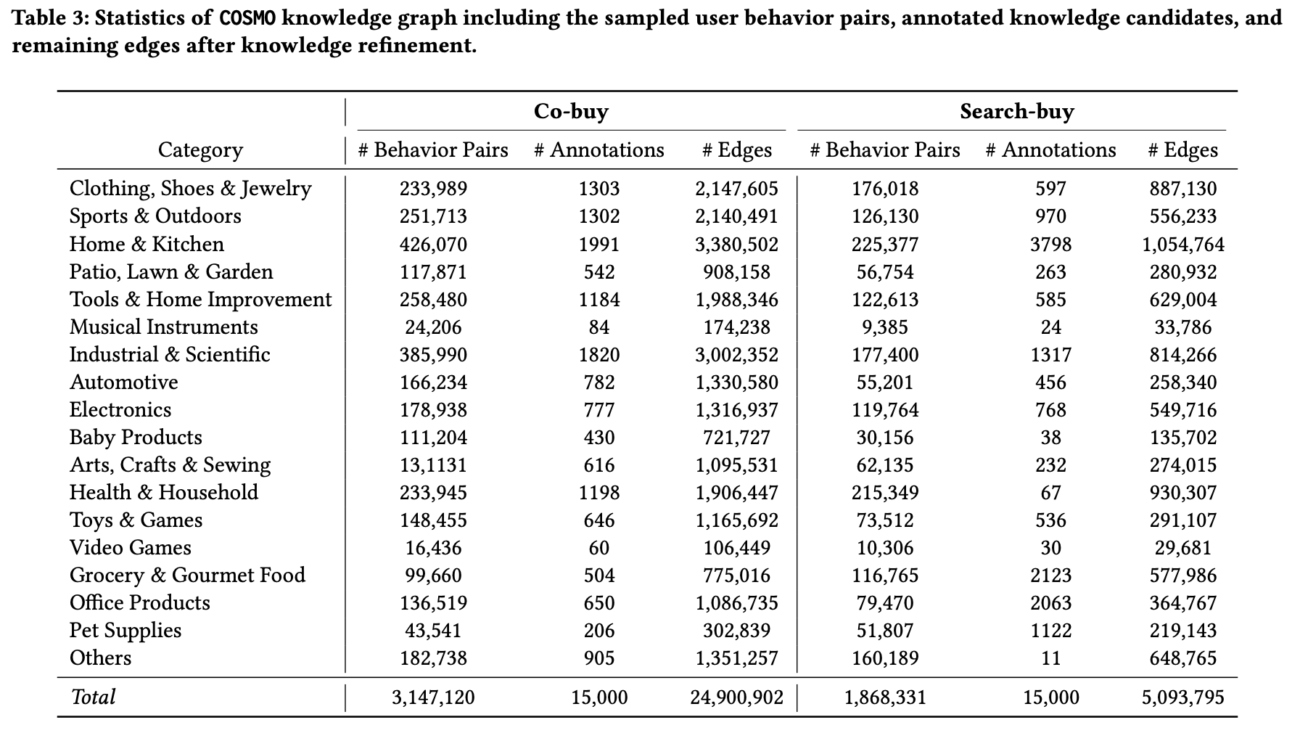
Knowledge generation
Proposed Framework
User Behaviour Sampling
Statistics of Sampled behaviour pairs among 3.14 million co-purchased product pairs

Slide 20
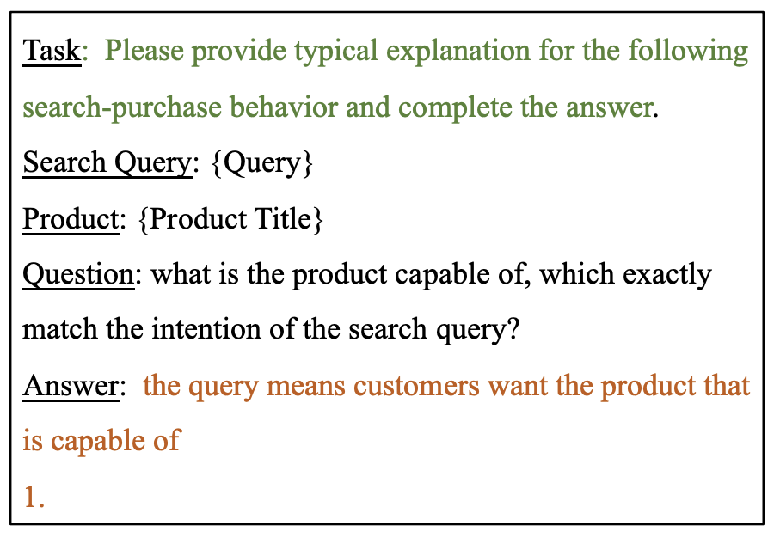
Knowledge generation
Proposed Framework
Question-Answering Based Prompts
Found that LLMs perform better when answering contextualized questions based on clearly described scenarios or task instructions.
Verbalize user behaviours by providing a QA context
Adding “1.”: Prompt engineering trick to generate list of knowledge candidates

Slide 21
Knowledge Refinement
Proposed Framework
Purpose: Eliminate noise from LLM-generated knowledge.
Two major steps: Automatic filtering + Human review.
Coarse-Grained Filtering
  Rule-based filtering
  Similarity filtering
Human-in-the-loop Annotation
  Re-weighting Strategy
  Annotation Criteria
  Quality Assurance

Slide 22
Knowledge Refinement
Proposed Framework
Coarse-Grained Filtering
Rule-based: NLTK + GPT-2 perplexity.
Filters repeats, incomplete sentences.
Similarity-based: Filters semantic redundancy via embeddings.

Slide 23
Knowledge Refinement
Proposed Framework
Human-in-the-Loop Annotation
15,000 examples labelled across user behaviours.
Re-weighted based on popularity & frequency.
5 annotation criteria: Complete, Relevant, Informative, Plausible, Typical.

Slide 24
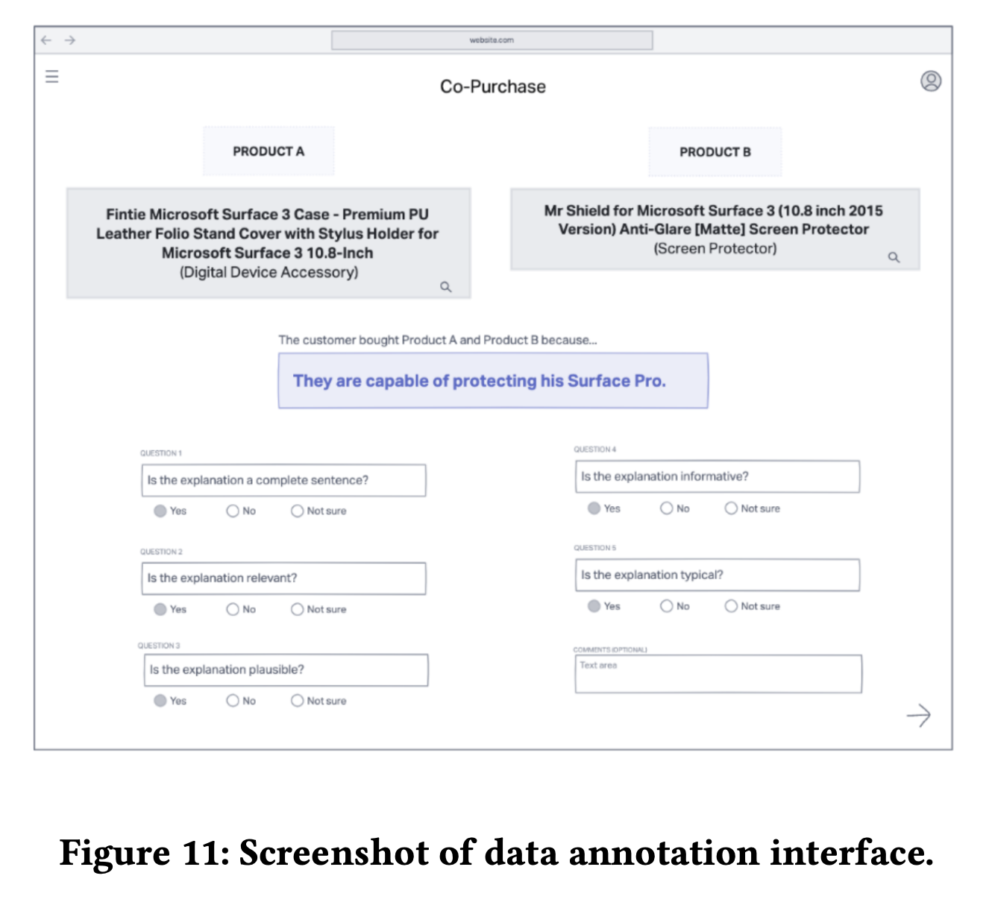
Annotation Principles
How COSMO Defines Good Knowledge
Completeness: Full, meaningful sentence.
Relevance: Closely tied to the product or query.
Informativeness: Explains the user’s need or intent.
Plausibility: Realistic behaviour in context.
Typicality: Reflects common user actions.

Slide 25
Knowledge Refinement
Proposed Framework
Quality Assurance & Final Filtering
90% audit accuracy.
Models like DeBERTa score remaining data.
Only knowledge with plausibility > 0.5 kept.

Slide 26
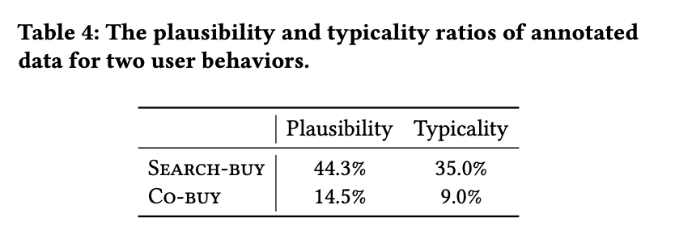
Instruction-tuned COSMO Language Model
Proposed Framework
30,000 human-labelled samples turned into instruction data.
Model trained on:
  18 product domains
  15 relation types
  5 tasks (including generation, plausibility, typicality, co-buy & search relevance)
Uses varied prompts (“user searched:”, “search query:”) for robustness.
Fine-tunes LLaMA 7B/13B models on this instruction data.

Slide 27
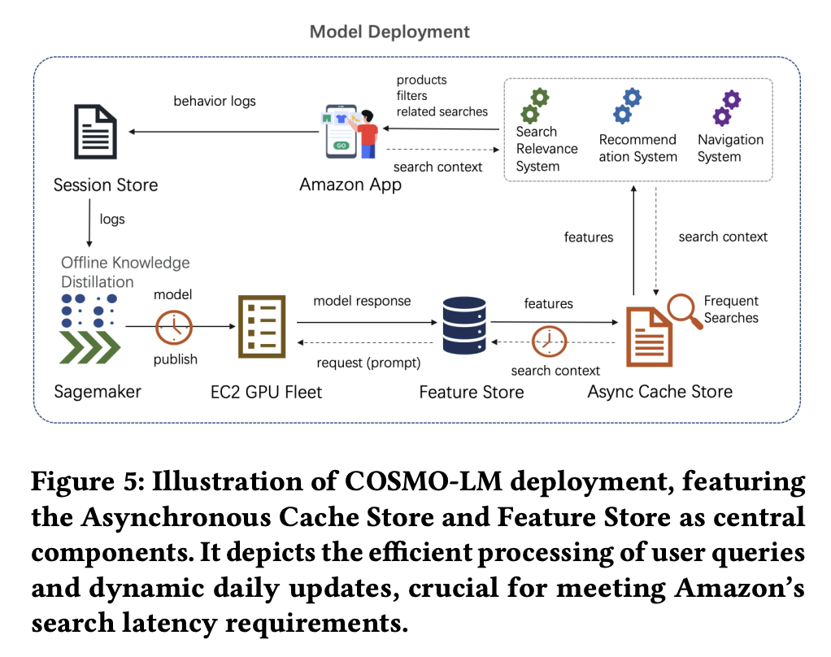
Online Deployment
Strategy
Uses SageMaker for scalable deployment and daily updates.
Feature Store and Async Cache Store are core infrastructure pieces.
Supports systems like search relevance, recommendation, navigation.

Slide 28
Online Deployment
Proposed Framework
Component Breakdown
Feature Store: Converts model outputs to structured data (e.g., key-value pairs, intents).
Async Cache Store: Handles frequent queries using layered caching.
Designed to meet strict latency and cost constraints.

Slide 29
Online Deployment
Proposed Framework
Operational Flow
Model ingests behaviour logs → SageMaker updates model.
Frequent queries answered via cache; others are batch processed.
Outputs stored and reused via Feature Store.
Results feed into Amazon apps (e.g., recommendations).

Slide 30
Online Deployment
Proposed Framework
Impact and Limitations
Meets latency requirements, scales economically.
Feedback loop improves model with user interactions.
Limitation: not ideal for real-time events like flash sales.

Slide 31
EVALUATIONS AND APPLICATIONS
COSMO is tested on 3 key downstream tasks:
  Search Relevance
  Session-based Recommendation
  Search Navigation
Evaluation is both offline and online.

Slide 32
Search Relevance
EVALUATIONS AND APPLICATIONS
Challenge: queries like “winter clothes” require background knowledge.
COSMO generates intent knowledge to explain search-buy behaviour.
Improves connection between query and product data.

Slide 33
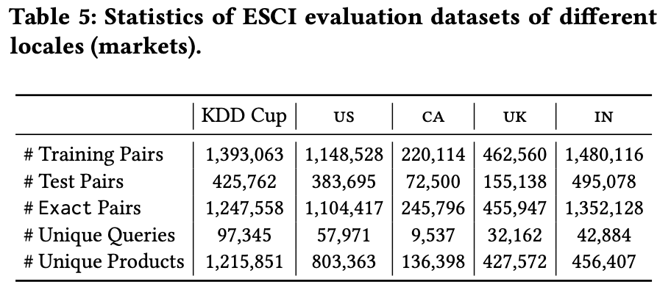
Search Relevance
EVALUATIONS AND APPLICATIONS
Experiment setup
Dataset: KDD Cup 2022 + Amazon internal datasets from 4 locales (US, CA, UK, IN).
4-class task: Exact, Substitute, Complement, Irrelevant.
Metrics: Macro F1 and Micro F1.

Slide 34
Search Relevance
EVALUATIONS AND APPLICATIONS
Baselines: Bi-encoder vs. Cross-encoder
Bi-encoder: Processes query and product separately.
Cross-encoder: Processes them jointly for better context.
Cross-encoder perform better →
  COSMO’s knowledge is added to Cross-encoder input.

Slide 35
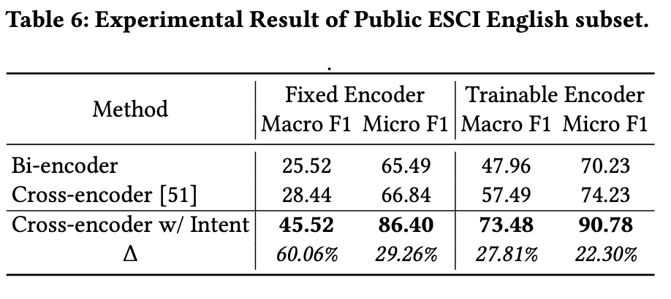
Search Relevance
EVALUATIONS AND APPLICATIONS
Public Dataset Results
COSMO improves Macro F1 by 60% and Micro F1 by 30% (fixed encoder).
Even with training, performance increases ~25%.
Beats top-1 model from KDD leaderboard.

Slide 36
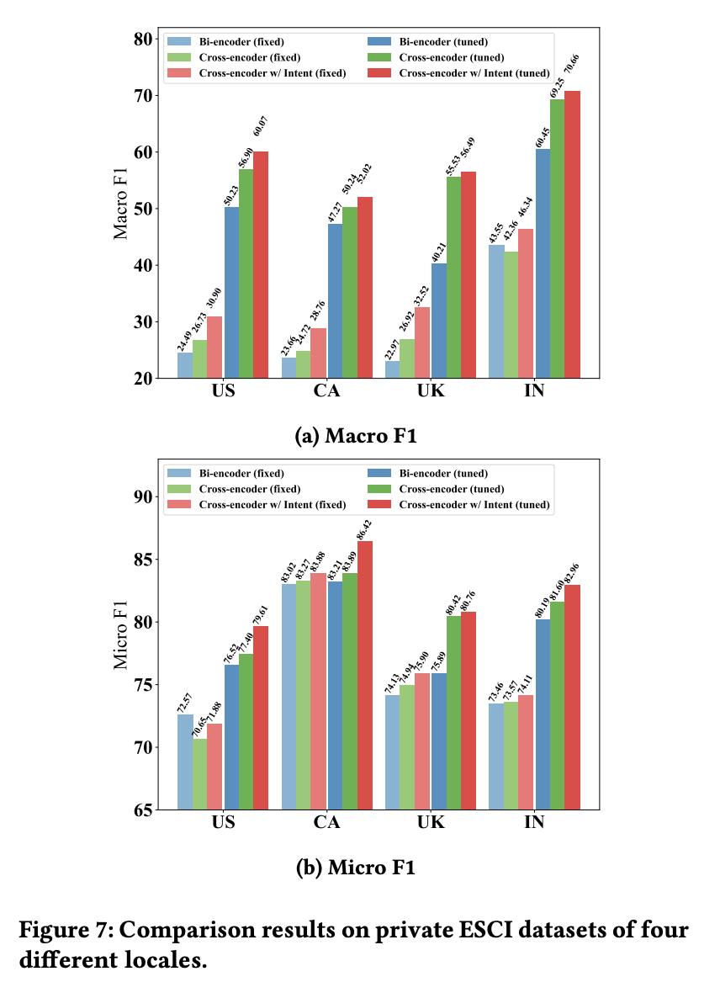
Search Relevance
EVALUATIONS AND APPLICATIONS
Private Dataset Results
COSMO improves performance across all regions.
Works well even with few annotations.
Cross-encoder w/ intent consistently best.

Slide 37
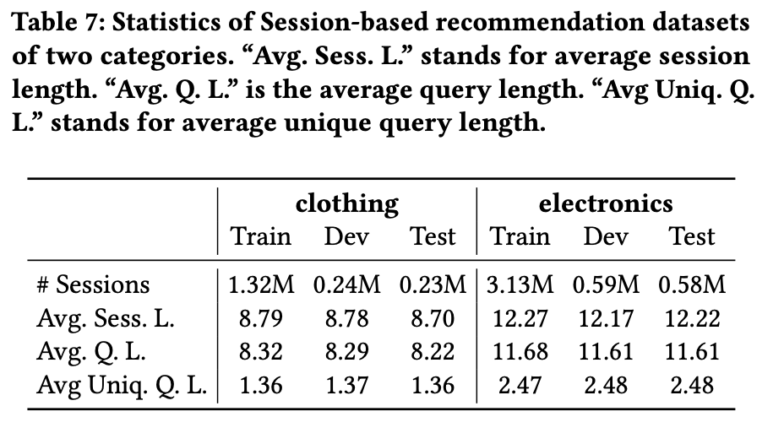
Session-based Recommendation
EVALUATIONS AND APPLICATIONS
Understanding User Intent with Session Data
Session-based recommendation models user behaviour over time.
COSMO enhances predictions using generated intent knowledge from query-product pairs.
Applies to domains like clothing and electronics.

Slide 38
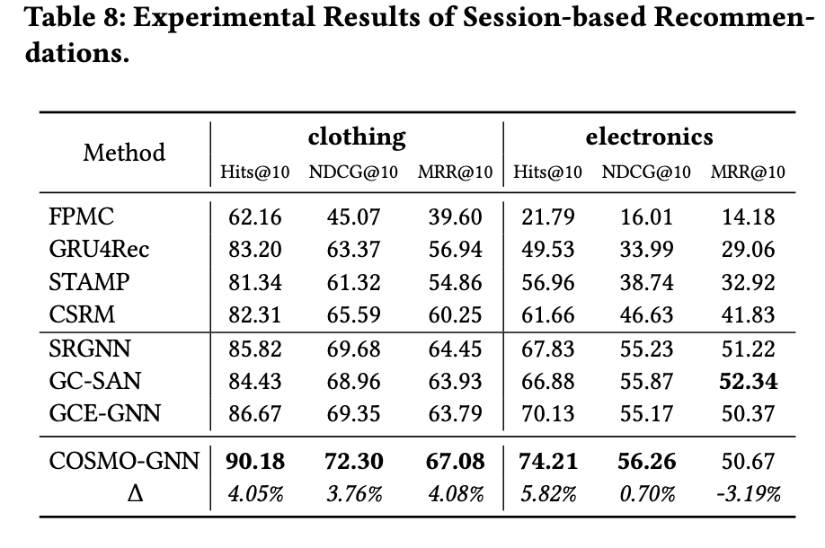
Session-based Recommendation
EVALUATIONS AND APPLICATIONS
Dataset & Setup for Session-Based Tasks
COSMO gives more accurate suggestions than standard methods.
Biggest improvements happen when users’ behaviour is more complex.
Helps predict what users really want, not just what they click.

Slide 39
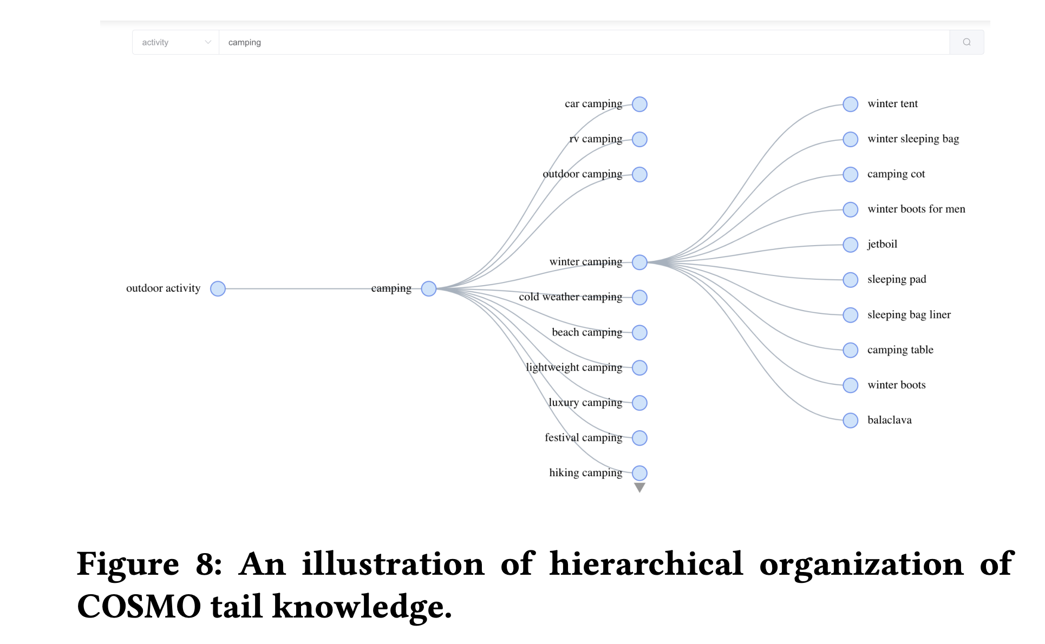
Search Navigation
EVALUATIONS AND APPLICATIONS
From Product-Centric to Intent-Centric Navigation
COSMO enhances search navigation by focusing on user intent rather than static product categories.
Dynamically builds hierarchies from general queries to specific needs.
Helps users discover relevant products more naturally.

Slide 40
Search Navigation
EVALUATIONS AND APPLICATIONS
Multi-Turn Navigation – Interpreting and Refining User Intent
Step 1: Understand broad queries (e.g., ‘camping’) using behavioural insights.
Step 2: Identify product types and subtypes to narrow down.
Step 3: Refine results by user-specific attributes like context or preference.
Enables multi-step, guided exploration of product space.

Slide 41
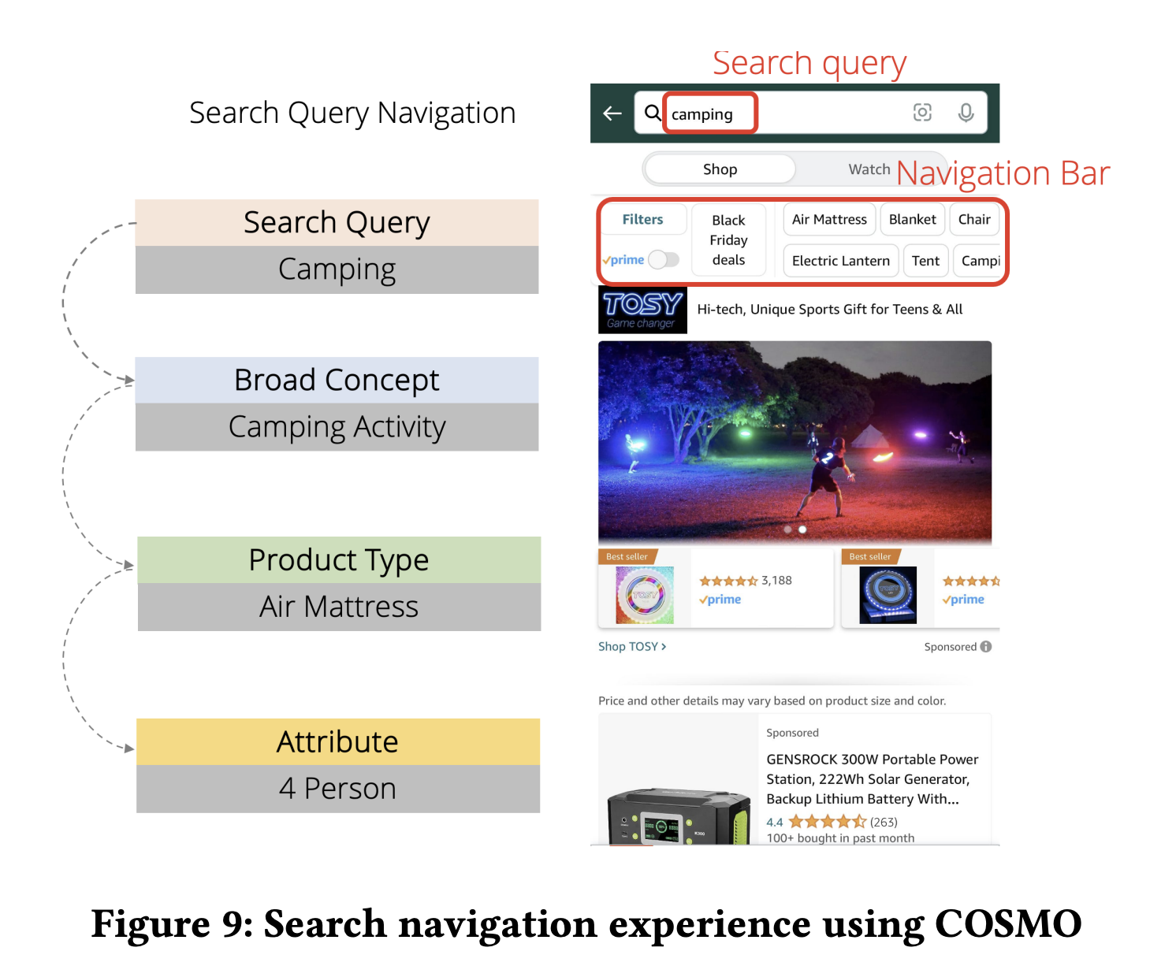
Search Navigation
EVALUATIONS AND APPLICATIONS
COSMO Boosts Search Navigation and Sales
A/B tests on 10% of Amazon US traffic.
+0.7% increase in product sales and +8% in engagement rate.
Achieved with a minor change on the search page.
Highlights potential for major future revenue and UX gains.

Slide 42
Conclusion
Key Takeaways from COSMO
COSMO fine-tunes language models on user behaviour data to generate commonsense e-commerce knowledge.
Uses scalable instruction-based training aligned with human intent.
Shows strong results in tasks like search relevance and recommendations.
Compared to raw LLM outputs, COSMO is smaller, faster, and more effective.

Slide 43
Thank you for your attention
Any Questions?

